Slide 1
私人和机密–仅适用于预期收件人。 在预期收件人之外散发此文档将作为民事和潜在的刑事起诉的依据
PRIVATE AND CONFIDENTIAL – FOR INTENDED RECIPIENTS ONLY. DISSEMINATION OF THIS DOCUMENT BEYOND THE INTENDED RECIPIENTS WILL BE GROUNDS FOR CIVIL AND POTENTIALLY CRIMINAL PROSECUTION
支持北京中国国家安全官员*（自称“迈克尔”）可能“与外国势力勾结”（可能）长达七 年（2013-2020年）的证据或更长时间
Evidence supporting assertion Beijing Chinese State Security officer* (who calls himself) “Michael” may have “colluded with foreign forces” (operated as a foreign intelligence agent) for (potentially) seven years (2013-2020) or longer
以及一些“软实力”解决方案来对付来自美国国防部（DoD）的无数仇恨病毒
And some “soft power” solutions to a myriad of hate viruses emanating from the American Department of Defense (DoD)
* 国家安全部; Guójiā Ānquán Bù 'State Security Ministry

Slide 2
动能在国外作业中的使用
Kinetic Energy in foreign operations
在2015年，我从未见过的外国老师来找我，问我问题。 例如：“您不高兴美国统治世界，而不是中国统治世界吗？” 那是开始对话的奇怪方式。 我通常以反问来回答他们的问题：“中国现在到底打了几场战争？” 不幸的是，我当时无法预料到，在未来五年内，将有一批外国人完全接管并完全控制学校的管理工作。
In 2015 foreign teachers I’d never met before came up to me and asked me questions. For example: “Aren’t you glad the USA is running the world, not China?” That is a strange way to start a conversation. I usually answered their questions with counter-questions like: “Exactly how many wars is China fighting now?” Unfortunately I could not have predicted at that time that a collection of foreigners would completely take over and totally dominate the school’s administration over the next five years.

Slide 3
蜂拥而至的情报行动 “Swarming” in intelligence operations
鉴于封闭环境中有足够数量的外国情报人员，完全诽谤个人非常容易。 我是学校中唯一喜欢并尊重中国政府的外国老师。 在我在那里教的大部分时间里，我是唯一的穆斯林外教。 “基督徒”逐渐接管了学校–一群人把我赶了出去。 这群人是由非常有偏见的外国老师和英语系的中国负责人领导的。 她还是北京这一地区大型地下教堂的首席部长。
一群蜜蜂在飞行
A swarm of bees in flight
Given a large enough number of foreign intelligence operatives within an enclosed environment it is very easy to completely defame an individual. I was the only foreign teacher at my school that likes and respects the Chinese government. I was the only Muslim foreign teacher for most of the time I taught there. The “Christians” gradually took over the school – and the swarm forced me out. The swarm was led by very prejudiced foreign teachers and the Chinese head of the English Department. She was also the chief minister of a large underground church in this district of Beijing.

Slide 4
外国情报人员的影响力导致“迈克尔”屡次犯罪 ¹
2009年至今
2015年– 2019年2月
2015
2016年– 2019年7月
外国情报官员，包括但不限于中央情报局和在北京汇佳私立学校任教的私人情报承包商。
孙秀娟AKA“雪莉”（Shirley），北京惠家私立学校IB课程英语系主任
北京汇佳私立学校“王志子”创始人退休，儿子“ CEO王”代替他
“王总”拥有成千上万的亿万富翁朋友，而且在许多部委，特别是教育部，体育部和国家安全部中，看似无限的关系
在工作地点，我受到了强烈的骚扰和诽谤。 这是由英语系负责人孙秀娟协调的，并得到了她（基督徒和其他）行政上的“朋友”，教师，教职员工，顾问和学生的支持。 2019年7月17日，我的工作被终止
在孙秀娟的授权下，我从GAC校园转到了IB计划英语系。 我被“锁定”在那个部门，不允许教任何其他学科。
2019年7月至今
在大型会议上，“王总”公开宣称无视中国法律，对特朗普总统表示钦佩。 “首席执行官王”似乎完全由孙秀娟控制，孙秀娟主要通过“基督徒”关系来销售学校。 大量的非法行为盛行。 基督教的“辅导员”完全控制每个学生在学校的教育。
孙秀娟是，或者至少是北京昌平区最大的基督教地下教堂的负责人。
其中有很多人，约瑟夫·布伦南（Joseph Brennan）是最有影响力的人之一。 我被录用时是唯一的穆斯林老师
刑事威胁和骚扰，诽谤，各种诱捕企图以及其他身心虐待。

Slide 5
Chain of foreign influence leading to “Michael’s” repeated criminal actions 1
2009-Present
2015 – 2019 February
2015
2016 – July 2019
Foreign intelligence officers including but not limited to CIA and private intelligence contractors working as teachers at Beijing Huijia Private School.
Sun Xiu Juan AKA “Shirley” former head of the English Department at Beijing Huijia Private School’s IB program
Founder of the school Wang Zhi Zi retires, his son “CEO Wang” replaces him
CEO Wang has thousands of billionaire friends, and seemingly infinite guanxi in numerous ministries, especially Ministry of Education, Ministry of Sport and State Security Ministry
Intense harassment and defamation of me coordinated by Sun Xiu Juan and supported by her followers in administration, the faculty, staff, counselors and students.
July 17, 2019 , my employment was terminated
I was moved from the GAC campus to the IB program English Department under the authority of Sun Xiu Juan. I am “locked” in that department and not allowed to teach any other subject.
July 2019 - Present
In large meetings CEO Wang openly boasts about ignoring Chinese law.
CEO Wang appears completely controlled by Sun Xiu Juan who markets the school through primarily “Christian” networks. Numerous illegal practices flourish.** All “Christian” School “counselors” take full control of students’ disposition at school.
Sun Xiu Juan is, or at least was the head of the largest Christian underground church in Changping District of Beijing.
Criminal threats and harassment, defamation, various attempts at entrapment, and other physical and psychological abuses
There have been many of them with Joseph Brennan being one of the most “influential.” I was the only Muslim teacher at the time I was hired

Slide 6
Chain of foreign influence leading to “Michael’s” repeated criminal actions 2
1994年– 1月13日，巴基斯坦-克什米尔在马来西亚出版 NST关于以色列在克什米尔战争中对印度的援助的国家报纸。 许多可怕的结果。1994, January 13 Pakistan – west Kashmir - I published article in Malaysia National Newspaper NST about Israeli aid to India in Kashmir War. Many terrible results.
2015 – 2019 February
2019
July 2019 - Present
2014 – Hong Qiao Private School on Zheng Fu Lu paints target on me. Repeated interrogations by “Michael.” 向我喷漆目标–国家安全部多次审问我 “Michael.”
2015 M.H. (M.H.) Job with Israeli 她在一家名为 Ofer Mizrahi Diamonds的以色列钻石公司工作。Threats of violence. 暴力威胁
Police arrest 警方逮捕亚优 Ya You from Chaoyang District – 他们找到了她买的房产，但不把赃款退还给M.H。locate properties she bought. But police unwilling to return stolen money to M.H.
2019年7月17日，我的工作终止了July 17, 2019 , my employment terminated
2019 September 另一名女子从M.H.偷了20万元 Another woman steals 200,000 RMB from M.H.
2009-Present
亚优 Ya You from Chaoyang District steals 800,000 RMB from M.H. 从朝阳区偷了M.H.的80万人民币。
December 2019 M.H. set up with very sophisticated rapist Zhang Peng Yue
2015 我开始丝绸之路功夫友谊之旅 I start Silk Road Kung Fu Friendship Tour
2009年，我开始在北京汇佳私立学校任教。2009 I start teaching at Beijing Huijia Private School.
July 25, 2020 After real dental appointment – with very bad news ( will lose another molar) Israeli flag motorcycle. Michael? It’s possible.
2016 我在北京昌平区被英语系主任（工作中）和首席基督教部长孙秀娟女士骚扰和诽谤。 在行政，教职员工，顾问，学生中，她的追随者为她提供了帮助。I was intensely harassed and defamed by head of English Department (at my job) and chief Christian minister in Changping District of Beijing Ms. Sun Xiu Juan. She was helped (in this effort) by her followers in administration, faculty, staff, counselors and students.
2019年4月11日最终确认-我在中国11年后遇到的第一位沙特人骚扰了我之后，我将不会立即被录用。2019 April 11 final confirmation I will not be rehired immediately followed by harassment by Saudi Arabian沙特人与基督徒一起进行非法行动。(Saudis working with Christians.)
2015 北京汇佳私立学校创始人退休，其儿子“首席执行官王”接替他Founder of the school Wang Zhi Zi retires, his son “CEO Wang” replaces him
2010 我开始发表有关在盘山重建北少林寺的文章。publishing articles about rebuilding North Shaolin Monastery on Panshan.
Also see Note on “Hate Sessions” held at Beijing Huijia Private School and Richard
2013-2018年，我与牙医吴爱婷一起在牙科工作上花费了40,000多元人民币–她的所有工作都存在一些问题，例如，牙帽太大会引起缝隙和感染。2013-2018 I spend over 30,000 RMB on dental work with dentist Wu Ai Ting - problems
2015年，我被迫进入北京汇佳学校的（IB）英语系。 该部门的负责人是孙秀娟女士。 她还是北京这一地区最大的基督教地下教会的首席部长。2015 I was put under authority of Sun Xiu Juan AKA “Shirley” at Beijing Huijia School – She is also head minister of the largest Christian underground church in this district of Beijing.
我想把过去抛诸脑后，但基督教部长孙秀娟、国家安全部迈克尔、以色列不会让我这样做。我和M.H.在北京发生的是一系列的犯罪。因为这些罪行，我们现在正遭受巨大的痛苦。I would like to leave the past behind, but Christian Minister Sun Xiu Juan, Ministry of State Security Michael, and possibly Israelis will not let me. What happened to me and M.H. here in Beijing was a long series of crimes. We have suffered for years and even more intensely now because of those crimes.
2019_07_08国家安全部“迈克尔”将于7月8日访问我的公寓。他提出了刑事威胁。 他对我与M.H.的关系特别感兴 “Michael”趣
Ministry of State Security “Michael” visit to my Apartment July 8. He made criminal threats. He has extreme interest in my relationship with M.H.

Slide 7
反情报的世界 The world of counterintelligence
反情报世界过去可能是而且经常是一个黑暗的肮脏世界。 是否有一些反情报官员实际上创造了虚构的“坏蛋”（涂抹好人）来促进职业发展？ 绝对可以。 他们的主管有时对此直接或间接负责吗？ 是。 他们有时收受贿赂迫害无辜的人吗？ 是。 他们有时会允许偏见和小嫉妒影响他们的评估吗？ 是。 这通常是一个阴暗的肮脏世界。
The world of counter-intelligence can be and often is a murky dirty world. Do some counter-intelligence officers actually create fictitious “bad guys” (smear good people) to advance their careers? Definitely yes. Are their supervisors sometimes directly or indirectly responsible for this? Yes. Do they sometimes take bribes to frame innocent people? Yes. Do they sometimes allow prejudice and petty jealousy to influence their assessments? Yes. It’s often a murky dirty world.

Slide 8
自我介绍 Self-Introduction
我护照上的名字叫格雷戈里·克里斯托弗·布伦戴奇。 我真的更喜欢阿卜杜勒·拉希德（Abdul Rashid）这个名字，但是全世界对穆斯林的仇恨实在太强大了。 我也非常喜欢并欣赏我的少林名字恒悟，以及我选择的中文名字石龙。
The name on my passport is Gregory Christopher Brundage. I really prefer the name Abdul Rashid, but the worldwide hatred of Muslims is too powerful. I also genuinely like and appreciate my Shaolin name 恒悟，and my chosen Chinese name 石龙。
我们是一个
We are One
https://sudeshdjvindia.blogspot.com/2018/01/religion-unity-humanity-vasudhaiva.html

Slide 9
自我介绍 Self-Introduction - 我是美国的反越战抗议者 Anti-Vietnam War protestor in the USA
从1969年到1975年，我是反越南战争的抗议者。因此，我的美国政府没有，而且仍然不喜欢我。 美国从与战争有关的公司收益中受益匪浅。 我讨厌那些从战争和杀戮中获利的人。 我在反战示威期间和之后被捕。 我从不从事或提倡暴力。 圣雄甘地的被动抵抗策略对我来说一直是并且仍然是一个强有力的榜样。 父亲在1969年夏天给了我一份《毛泽东语录》（《小红皮书》）。我非常喜欢这些语录，但想知道是否总是需要暴力来带来社会主义变革。 我仍然希望教育和交流能比暴力更好。
I was an anti-Vietnam war from 1969 to 1975. Consequently my American government did not, and still does not like me. The USA benefits greatly from corporate earnings related to war. I loath those who earn profits from war and killing. I was arrested during and after anti-war demonstrations. I never engaged in or promoted violence. The passive resistance strategy of Mahatma Gandhi was and remains a powerful role model for me. My father gave me a copy of Mao Tse Tung’s quotations (Little Red Book) during the summer of 1969. I very much like the quotations, but wondered if violence is always necessary to bring socialist change. I still have hope education and communication can teach better than violence.

Slide 10
自我介绍 Self-Introduction
读者可能不知道这一点，但是伊斯兰教是和平的宗教。 除非被用于政治目的，否则大多数伟大的宗教都是和平的。 无疑，马克思和恩格斯（有充分的理由）对俄罗斯东正教的力量感到恐惧。 俄罗斯东正教教堂是罗马皇帝君士坦丁在325年创立的“基督教”品牌的后代。它被设计为战争工具。 我希望读者能原谅这些见解。 我的父亲是天主教徒，是一位备受尊敬的历史学家。 我比大多数人更了解历史。 在梵蒂冈图书馆学习过多之后，我父亲成为了无神论者。
The reader may not know this, but Islam is a religion of peace. Most of the great religions are peaceful, unless they are being used for political purposes. Certainly Marx and Engels were (with good reason) terrified of the power of the Russian Orthodox Church. The Russian Orthodox Church is a descendant of the brand of “Christianity” created by Roman Emperor Constantine in the year 325. It is designed as an instrument of war. I hope the reader will forgive these insights. My father was a Catholic and a highly respected historian. I know the histories better than most people. After too much study in the Vatican Library, my father became an atheist.

Slide 11
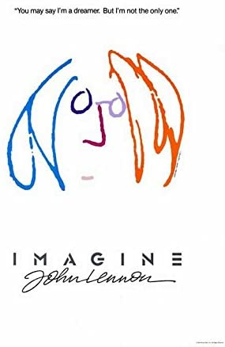
自我介绍 Self-Introduction
我一生都在研究不同的道德哲学和宗教。 我知道他们基本上都和共产主义一样，有着相同的目标。 他们都希望人与人之间的和平与稳定。 战争，民族主义，部落主义，种族主义和宗教偏执是不受限制的资本主义的产物。 所有伟大的宗教清楚地表明，大多数有钱人都下地狱！ 我们，热爱和平的人民，基本上都是一样的。 原谅别人，帮助穷人，诚实诚实。 这就是我所相信的。
I have spent my life studying different moral philosophies and religions. I know they are all in many ways the same and share the same goals as communism. They all want peace and stability within and between people. War, nationalism, tribalism, racism, and religious bigotry are product of unrestrained capitalism. All of the great religions clearly state most of the rich all go to hell! We, the people who love peace, are essentially all the same. Forgive others, help the poor, be honest and sincere. This is what I believe.

Slide 12
自我介绍 Self-Introduction
我在1987年成为穆斯林，以结婚。 随后的32年是“艰难的”。 我于2009年从韩国移居北京，在北京市昌平区的北京惠家私立学校任教。 然而，我的主要动机是逃脱在韩国似乎主要有兴趣与我做爱派对的假基督徒。 而且，我读到北少林寺位于天津集贤盘山的位置。 自从我很小的时候就从父亲那里听说过少林，我就爱上了少林。 我一生从未参加过性派对。 我不想在韩国以假基督徒开始。I converted to Islam in 1987 to get married. The subsequent 32 years have been “difficult.” (See Attachments 1 a, b, c) I moved to Beijing in 2009 from South Korea to teach at Beijing Huijia Private School in Changping District of Beijing. My primary motive however was to escape the fake Christians in South Korea that mainly seemed interested in having sex parties with me. And, I read that the location of the North Shaolin Monastery on Panshan, Jixian, Tianjin had been found. I have loved the Shaolin since I first heard about it from my father when I was very young. I have never once in my life gone to sex parties. I did not want to start in South Korea with fake Christians.

Slide 13
自我介绍 Self-Introduction
大约在1972年，我还是个少年时，我就开始学习功夫以及有关中国历史，哲学和医学的知识。我非常热爱中国，并非常感谢我被允许在中国生活和工作11年。 （请参阅附件护照扫描）
I first started learning Chinese Wushu Kung Fu history, philosophy and medicine when I was a young teenager in about 1972. I very much love China, and appreciate that I have been allowed to live and work here in China for 11 years. (See Attachments 2 a & b Passport Scans)
除了过去11年的教学工作外，我还成为世界上有关中国武术功夫的出版最多的作家，并且广泛出版了有关“一带一路”计划的丝绸之路之旅。 我对中国武术功夫和丝绸之路的非常积极的宣传在弗吉尼亚州兰里引起了人们的关注。
In addition to my teaching job during the past 11 years I have also become the world’s single most prolific published writer about Chinese Wushu-Kung Fu, and have published extensively about my Silk Road travels in support of the One Belt, One Road Plan. My very positive promotion of Chinese Wushu Kung Fu and the Silk Roads however has not gone unnoticed in Langley Virginia.

Slide 14
自我介绍 Self-Introduction
在此PPT中提出的问题很简单： 1）中国当局是否允许我受中情局下属的酷刑和杀害，作为对我（过去32年）作为穆斯林并在我在中国的11年中宣传中国艺术，历史，文化和语言的惩罚？可悲的事实是，我和我的朋友苗慧现在在北京在身心上遭受酷刑。我会被迫返回美国吗？在那儿，我肯定会受到更极端的折磨，然后被杀害。2）这是中国的官方政策，还是中国国家安全部和其他部委腐败的副产品？长期以来，我一直不愿意参加“伟大的游戏”。 3）您的中国（腐败）“情报”爱好者会不会最终终结我？4）那中国公民苗慧呢？ 5）您是否也允许她在您国家安全部的腐败中遭受酷刑？ （显然，因为她的日常生活现在是地狱，所以答案是肯定的。）6）根据中国法律，这合法吗？显然不是，但是由于警察的腐败，反正一直在发生。
The questions asked in this PPT really are 1) Will Chinese authorities allow me to be tortured and killed by subordinates of the CIA, as punishment for being a Muslim (for the past 32 years) and promoting Chinese arts, history, culture and language during my 11 years here in China? The sad fact is I, and my friend M.H., are being physically and psychologically tortured now here in Beijing. I am also being forced to return to the USA where I will definitely be tortured in a more extreme manner, and then killed. 2) Is this official Chinese policy, or the byproduct of corruption in the Chinese Ministry of State Security and other ministries? I have been an unwilling participant in the “Great Game” for far too long. 3) Are your Chinese (corrupt) “intelligence” amateurs going to finally put an end to me? 4) And what about Chinese citizen M.H.? 5) Will you permit her to be tortured as well by the corruption in your Ministry of State Security? (Obviously the answer is yes as her daily life is hell now.) 6) Is that legal according to Chinese law? Obviously not, but it’s happening anyways thanks to police corruption.

Slide 15
自我介绍 Self-Introduction
在这个PPT中，有证据表明国家安全官员“迈克尔”曾多次从事针对我本人格雷戈里·克里斯托弗·布伦达格和我的朋友中国公民苗辉的犯罪活动。
In this PPT, evidence is presented indicating State Security officer “Michael” has repeatedly engaged in criminal activity directed at myself Gregory Christopher Brundage and friend Chinese citizen M.H..
一 证明”Michael”故意犯了许多刑事罪行。
二 有力的证据有力地证明了迈克尔担任过外国代理人。
三 有证据表明，“迈克尔”是反穆斯林的偏执者，不“赞成”我与苗慧女士的关系。 他利用国家资源追求基于仇恨和偏见的个人议程，同时明知允许自己被用作敌对外国势力的代理人。
仇恨是一种比COVID-19更严重的融合病毒
'
Proof “Michael” has knowingly committed numerous criminal offenses.
The weight of evidence strongly indicates Michael acted as a foreign agent.
Evidence also strongly suggests “Michael” is an anti-Muslim bigot that does not “approve” of my relationship with Ms. M.H.. He has used state resources to pursue a personal agenda based on hatred and prejudice while knowingly allowing himself to be used as an agent of a foreign power hostile to China.

Slide 16
北京汇佳私立学校的背景一：“仇恨会议” Background on Beijing Huijia Private School 1: “Hate Sessions”
2017年11月10日星期五会议-北京汇佳私立学校的所有师生都必须参加。家长们也被邀请了。这次会议围绕一个名为“最有可能成功”的视频为中心，向教师、家长和学生揭露了令人发指的种族主义、反穆斯林和反巴基斯坦的成见和偏见。这段视频后来从YouTube上撤下，只是在我强烈抗议视频中传播的种族主义、反穆斯林和反巴基斯坦偏见之后。我不知道，但怀疑巴基斯坦政府可能游说YouTube删除视频。这是非常令人不安的。然而，我是第一个发表书面抗议的人，反对极端的，高度煽动性的次主题编织在整个肮脏的充满仇恨的视频。问：CEO是如何批准这段视频的？在被迫看了这段可恶的视频后，我向校园东侧走去。我看到孙秀娟女士一路笑着和她谄媚的朋友聊天。她似乎觉得这部电影确实很有趣。孙秀娟有没有向王总推荐这部电影？如果是，是谁把这部电影介绍给孙秀娟女士的？也许是外国人？
November 10th 2017 Friday Meeting – All teachers and students and teachers at Beijing Huijia Private School were required to attend. Parents were also invited. This meeting centered around a video titled: “Most Likely to Succeed,” exposing teachers, parents and students to outrageous racist, anti-Muslim and anti-Pakistani stereotypes and prejudice. That video has since been taken off YouTube, only after I vigorously protested the racism, anti-Muslim and anti-Pakistani bias spread throughout the video. I don’t know but suspect the Pakistani government probably lobbied YouTube to remove the video. It was extremely disturbing. I was however the first to publish a protest objecting to the extremist, highly inflammatory subthemes woven throughout that scurrilous hate-filled video. Question: How did CEO come to approve this video? After the video I walked towards the east side of campus. I saw Ms. Sun Xiu Juan laughing all the way chatting with her sycophantic friends. She appeared to find the movie very funny indeed. If Ms. Sun Xiu Juan recommended it to CEO Wang, who introduced this movie to her? A foreigner perhaps?

Slide 17
在北京汇嘉私立学校举行的“仇恨讲座” 1 b –我的电影评论（已出版） “Hate Sessions” held at Beijing Huijia Private School 1 b – My published review of movie
“最有可能成功”-明显的偏见被打扮成“渐进式教育”。“Most Likely to Succeed” - Overt bigotry dressed up as “progressive education.” 格雷格·布伦戴奇（Greg Brundage），2017年11月10日 By Greg Brundage, 10 November 2017
尽管这部由格雷格·怀特利（Greg Whiteley）执导的2015年电影受到好评，但仍然存在一些严重问题。 主题是替代教育，没有课，书或测试。 但是，暴力和恐怖是一个反复出现的子主题。 这个重复出现的子主题来自一个学生剧中一个名叫Malala Yousafzai的英雄女人的故事。 不幸的是，她的故事根本没有被讲述。 取而代之的是，巴基斯坦恐怖分子反复出现的场面最终导致巴基斯坦恐怖分子殴打一个年轻的无辜白人女孩。 对于本来应该在加利福尼亚进行渐进式教育的电影来说，这部电影是失败的，因为它宣传偏执和偏见。 作家兼导演格雷格·怀特利应该感到愧。 学校不应该播放这部电影，学生也不应该受到这种明显的偏见。 这部电影在被称为“进步教育”的同时，也强化了穆斯林和巴基斯坦人最负面的刻板印象。Though this 2015 movie written and directed by Greg Whiteley has gotten rave reviews, there are some serious problems. The theme is alternative education without classes, books or tests, but there is a recurring sub-theme of violence and terror under the pretext of a student play about a heroic woman named Malala Yousafzai. Unfortunately her story is not told at all, and instead there are recurring scenes of terrorists culminating in the beating of a young innocent white girl by Pakistani terrorists. For a movie that's supposed to be about progressive education in California this movie is a failure as it promotes bigotry and prejudice. The writer and director Greg Whiteley should be ashamed. Schools should not air this film and students should not be subjected to such overt prejudice reinforcing the most negative stereotypes of Muslims and Pakistanis dressed up as "progressive education."
https://www.imdb.com/title/tt4267108/reviews?ref_=tt_ov_rt

Slide 18
在北京汇佳私立学校举行的“仇恨会议”-示例2“ Hate Sessions” held at Beijing Huijia Private School - Example 2
2019年1月6日，北京汇佳私立学校（高中）历史教师理查德·拉科维茨先生在周一上午学校升旗仪式上作报告。所有学生和教师都必须出席。拉科维茨先生在发言中非常有力地指出俄罗斯和伊朗是世界恐怖主义的主要来源。他的视频以一系列核爆炸开始，伴随着巨大的爆炸声和尖叫声。接下来是温斯顿·丘吉尔和富兰克林·D·罗斯福的戏剧性演讲视频。紧接着是一场演讲，将俄罗斯和伊朗妖魔化，并将它们列为危险的恐怖国家。他的整个演讲都是充满仇恨的演讲，有非常强大的视频支持。在他令人惊叹的演讲结束后，学生们不得不站起来，面对中国国旗，并承诺要成为“好中国人”。这太不可思议了。拉科维茨先生是一位来自纽约的支持犹太复国主义的犹太人。他还与一些教员合作诽谤我。
January 6, 2019 Mr. Richard Rakowitz the International Baccalaureate® (IB) History teacher made a presentation at a Monday morning Flag Raising ceremony at Beijing Huijia Private School. Attendance was mandatory for all students and teachers. In that Presentation Mr. Rakowitz very powerfully labeled Russia and Iran as the primary sources of world terrorism. His video started with a series of nuclear explosions with very loud explosion sounds and screaming. This was followed by dramatic videos of speeches by Winston Churchill and Franklin D. Roosevelt. Those were followed by a lecture demonizing Russia and Iran and labeling them as dangerous terrorist states. His entire presentation was a hate speech with very powerful video support. After his stunning presentation students had to stand up, face the Chinese flag and promise to be “good Chinese.” It was surreal. Mr. Rakowitz is a pro-Zionist Jewish man from New York. He also coordinated with some faculty in defaming me.

Slide 19
在北京汇佳私立学校举行的“仇恨会议”
前几张幻灯片中提到的两次“仇恨会议”并不是北京汇佳私立学校极端主义和仇恨的唯一指标。这里引用他们来强调种族主义和反穆斯林仇恨的普遍心理，这种心理从2015年开始渗透到北京汇佳私立学校。2015年，这所学校的创始人退休了，他的儿子（CEO王）接手了。前英语系主任孙秀娟女士（她也是北京这个地区最大的地下教会的负责人）对王首席有着巨大的权力。即使在她2019年2月退休后，这种权力依然存在。她让一个非常富有的女人退休了。上次我见到她时，她开的是一辆大型的鲜红色奔驰车。
The two “Hate Sessions” referred to on previous slides were not the only indicators of American extremism and hatred at Beijing Huijia Private School. They are cited here to emphasize the pervasive psychology of racism and anti-Muslim hatred that permeated Beijing Huijia Private School from 2015. It was in 2015 the founder of that school retired and his son (CEO Wang) took over. Former Head of the English Department Ms. Sun Xiu Juan (who was also the head of the largest underground Christian church in this district of Beijing) had enormous power over CEO Wang. That power continued even after she retired in February 2019. She retired a very wealthy woman. The last time I saw her she was driving a jumbo-size bright red Mercedes Benz.

Slide 20
2019年6月13日和2019年6月25日
一名“国家安全部”官员屡次犯罪（“迈克尔”） Repeated criminal actions by 'State Security Ministry’ officer calling himself “Michael”
可证明的 Provable
2019年6月13日，我在北京获得了难民署的寻求庇护者证书。 （请参阅附件1寻求庇护者证书和附件3a BRUNDAGE在中国进行政治庇护的原因Rev_May 9_2019）; 附件3 b寻求庇护者证书
June 13, 2019 I was given an Asylum Seeker Certificate by UNHCR in Beijing. (See Attachments 1 Asylum seeker certificate and Attachment 3a BRUNDAGE Rational for Political Asylum in China Rev_May 9_2019) ; Attachment 3 b Asylum Seeker Certificate
b) 在2019年6月25日的联合国难民署会议上 - 北京市朝阳区新源西里中街18号，渔阳饭店，三层文化厅 - “迈克尔”是国家安全部的唯一代表。大约有35人出席了会议，其中包括难民署官员，至少有25人获得政治庇护或正在寻求政治庇护。在那次会议上，几名政治庇护寻求者抱怨说，当地警察拒绝向他们提供“住宿登记表”。他们说：“当地警察局的警察没有政治避难者的信息。”
June 25, 2019 at the (CHIBE) UNHCR meeting held in the - Culture Meeting Room, Third floor at the Yu Yang Hotel, No.18 Xinyuanxili Middle Street, Chaoyang District, Beijing, “Michael” was the representative of the State Security Ministry. There were about 35 people in attendance, including UNHCR officials, and at least 25 people who had either been granted Political Asylum or who were seeking it. During that meeting, several of the Political Asylum seekers complained of local police refusing to give them “Accommodation Registration Forms.” (住宿登记表 Zhùsù dēngjì biǎo). “Police in the local police stations had no information on Political Asylum Seekers,” they said. Attachment 4 CHIBE Meeting email 2019_06-25

Slide 21
注释1（第2页） Notes Page 2 2019年6月25日
c. 在演讲台上，“迈克尔”说，北京周边各派出所的所有警察都已被告知政治避难者，并被要求向持有政治避难证明的人提供“住宿登记表”。
c. At the speakers podium “Michael” said all police in all stations around Beijing had been informed regarding Political Asylum Seekers and were required to give “Accommodation Registration Forms” to those with Political Asylum Seeker Certificate.
观众右边的几个寻求政治庇护的人回答说，警察不会给他们“住宿登记表”，并一再骚扰他们。
Several political asylum seekers on the right side of the audience responded the police would not give them “Accommodation Registration Forms” and police repeatedly harassed them.
听众中的一位妇女是一位已婚的中年穆斯林非洲妇女，有孩子，据报道，她被判入狱三个星期。 这是因为她没有“住宿登记表”。 她获得了政治避难者证书，并反复尝试从当地警察局索取“住宿登记表”。 警察没有给她“住宿登记表”，因为他们“对政治避难者一无所知”。One woman in the audience – a married middle-age Muslim African woman with children – reported that she had been jailed for three weeks because she didn’t have the “Accommodation Registration Form” in spite of 1) having the Political Asylum Seeker Certificate and repeated attempts to get the “Accommodation Registration Form” from her local police station.

Slide 22
一些中国人感染了来自欧美一些国家的“仇恨病毒”。Infection with the Euro-American “hate virus”
也许迈克尔或他的上司不知道。在伊斯兰教中，妇女受到某些保护。尤其是母亲受到非常特殊的保护。对这名妇女的骚扰和迫害比迈克尔（或他的老板）所意识到的更严重地损害了中国和穆斯林的关系。中国有一种强烈的反穆斯林偏见，主要来自（讲英语的）中国人，以及那些与外国人学习或工作最密切的中国人。
Perhaps Michael or his supervisors doesn’t know. In Islam women are given certain protections. Especially mothers are given very special protection. The harassment and persecution of that woman did more to hurt China/Muslim relations than Michael (or his bosses) realize. There is a strong anti-Muslim prejudice in China emanating primarily from English speaking Chinese, and those Chinese who studied or worked most closely with foreigners.

Slide 23
美国媒体也在策划中国人憎恨穆斯林和他们自己 American Media is also programming Chinese people to hate Muslims, and themselves
就拿电视惊奇漫画系列《高谭》为例。它真的很好，除了唯一的中国人是邪恶的，他们折磨和杀害他，唯一有穆斯林名字的人是邪恶的，他们折磨和杀害他。如果没有那些政治驱动的毒丸子主题，这将是一个出色的系列。那些毒丸的副主题隐藏在显而易见的视野中，但我敢打赌，大多数人在看电视的时候不会进行批判性思考，因此在不知不觉中被催眠成仇恨。那真是太老练了。它在中国的电视上播出。全世界大部分地区都在遭受仇恨病毒的折磨，这是一种比COVID-19更致命的病毒。美国的大众媒体经常宣传这种仇恨病毒。
Take for example the TV Marvel Comics series Gotham. It's really excellent except the only Chinese is evil and they torture and kill him, and the only person with a Muslim name is evil and they torture and kill him. Without those politically driven poison-pill sub-themes it would have been an excellent series. Those poison-pill subthemes are hidden right in plain view, but I'll bet most people don't think critically while they are watching TV - and so are being hypnotized into hatred without their awareness. That's pretty sophisticated really. It is on TV here in China. Most of the whole world is suffering from the hate virus, a much more deadly virus than COVID-19. American media drives that hate virus.

Slide 24
American TV show “SIX”
六（风格化为六）是美国军事戏剧电视连续剧。
该系列是由历史频道订购的，首季有8集。
Six (stylized as SIX) is an American military drama television series. The series was ordered by the History channel with an
eight-episode initial order.
电视连续剧统一地将穆斯林描述为恶性恐怖分子，并制造出对诸如“ Allahu Akbar”之类的关键穆斯林短语的“经典条件”仇恨，这意味着“上帝是伟大的”。 该电视连续剧的所有观众都习惯于恐惧和憎恨穆斯林以及关键的伊斯兰短语。The TV series uniformly characterizes Muslims as cruel terrorists and creates “classical conditioning” hatred of key Muslim phrases like “Allahu Akbar” which means “God is great.” All viewers of that TV series are conditioned to fear and hate Muslims and key Islamic phrases.

Slide 25
有数百种有毒的美国电视节目和电影都在做同样的事情：妖魔化穆斯林和伊斯兰教。
There are hundreds of poisonous American TV shows and movies that do the same thing: demonizing Muslims and Islam.
现在，美国大众传媒以完全相同的方式妖魔化了中国。Now, it’s China’s turn to be demonized in precisely the same way by the American mass media.
从逻辑上讲，中国人民和政府可以考虑重新评估中国穆斯林和伊斯兰教的形象。 极其不公正的陈规定型观念必须用公正的历史和媒体特征来代替。
Logically, Chinese people and government might consider re-evaluating the image of Muslims and Islam in China. Horribly unfair stereotypes need to be replaced with fair histories and media characterizations.

Slide 26
难民署会议 2019年6月25日
一小群（所有非洲人）穆斯林政治寻求庇护者聚集在观众的右边。 从针对“迈克尔”的评论和问题来看，他们似乎很难获得“住宿登记表”。 他们最经常被警察骚扰。 The small group of (all African) Muslim Political Asylum Seekers were clustered together on the right side of the audience. Judging by their comments and questions for “Michael” they appear to have had a very difficult time. They were frequently harassed by police.
相比之下，在中国基督教组织的帮助下带到中国的政治避难者在获得极其重要的“住宿登记表”方面没有问题。In contrast, the Political Asylum Seekers brought to China with the assistance of Chinese Christian organizations appeared much quieter and did not appear to have had problems getting the extremely important “Accommodation Registration Form.”
面对那次会议上来自穆斯林少数群体的众多投诉，“迈克尔”说，他将再次通知所有警察局的警察，向持有政治避难者证书的人提供“住宿登记表”。后来证明这是谎言。
Faced with a barrage of complaints from the small Muslim minority at that meeting, “Michael” said he would again inform police in all police stations to give the “Accommodation Registration Form” to those with the Political Asylum Seeker Certificate. This later turned out to be a lie.

Slide 27
破坏``一带一路‘’倡议 Destabilizing the Belt and Road Initiative
有联合国难民事务高级专员办事处 –名代表在场。有很多目击者。 这似乎是中国的国家政策。 但是，将穆斯林作为骚扰的目标，不可能帮助建立或维持“一带一路”倡议。 一带一路的大多数国家都是穆斯林。 许多穆斯林国家已捐款大量。 当然，大多数国家领导人把钱放在第一位，但是巴勒斯坦和其他穆斯林国家的持续侵蚀使对穆斯林的迫害成为任何国家政策中的重大缺陷。 UNHCR Representatives were there. There are many witnesses. This appears to be Chinese state policy. However, focusing on Muslims as targets of harassment is not likely to help build or maintain the Belt and Road Initiative. Most Belt and Road countries are Muslim. Many Muslim countries have contributed significant amounts of money. Of course, most national leaders put money first, however the continued erosion of Palestine and other Muslim countries makes persecution of Muslims a profound flaw in any national policy.

Slide 28
注释1（第4页） 2019年7月8日 Notes Page 4 – Michael’s failure to inform Police Stations
2019年7月8日。早上，我去当地的警察局索取了一份新的“住宿登记表”。July 8, 2019. In the morning I went to the local police station to get a renewed “Accommodation Registration Form.”
昌平区派出所的警察从未听说过“政治避难证明”。 看来他们打电话给“国家安全部”以获取信息。 迈克尔没有履行向当地警察局提供信息的承诺。 （有关寻求政治庇护者的信息以及警方提供“住宿登记表”的义务。）至少在政治寻求庇护者是穆斯林的情况下，这是迈克尔一贯的错误。 我是穆斯林，他知道。 Police at the police station in Changping District had never heard of a “Political Asylum Certificate.” It appears they called the Ministry of State Security for Information. Michael failed to fulfill his promise to inform local police departments regarding Political Asylum seekers and the police obligation to provide “Accommodation Registration Forms.” This is a consistent “error” Michael appears to make at least for Muslim Political Asylum seekers. I am a Muslim and he knows it.

Slide 29
迈克尔的首要任务：我和苗慧的关系 2019年7月8日 Notes Michael’s priority: My relationship with M.H.
那天下午早些时候，迈克尔在另一名警察的陪同下参观了我的公寓。 他首先问我为什么不娶未婚夫苗慧。 我告诉他，这是由于美国州离婚法的复杂性导致我无法与前妻离婚。 25年来，我与前妻没有亲密关系。 美国的50个州中的每个州都有不同的离婚法。 威斯康星州要求我在那住六个月以申请离婚。 我知道，如果我住在威斯康星州，我的生命将处于极端危险之中。 如果可以的话，我本来可以和我的未婚夫苗慧结婚的。 但是在中国，如果没有美国威斯康星州的离婚证件，我就无法结婚。
Early that afternoon Michael accompanied by another police officer visited my apartment. He first asked why I did not marry my fiancée, M.H.. I told him it was due to complications in American State Divorce law that did not allow me to divorce my (former) wife. I have not been intimate with my former wife in 25 years. Each of the 50 states in the USA has different divorce laws. The state of Wisconsin requires I live there for six months to petition for divorce. I know my life would be in extreme danger if I lived in Wisconsin. I would have married my (then) fiancée M.H. if I could have. However in China I cannot marry without a divorce paper from the state of Wisconsin USA.
附件5：2019_07_08 Michael将于7月8日访问我的公寓-他的非法威胁
Attachment 5: 2019_07_08 Michael Visit to my Apartment July 8_threats

Slide 30
注释1（第6页） 迈克尔的威胁 Michael’s Threats 2019年7月8日 Notes Page 6
迈克尔却不理我的解释。 取而代之的是，他关闭了他的警用摄像机和麦克风，然后嘶嘶地说：“你必须离开昌平区。 有了这个（把我的“政治寻求庇护者证书”扔在桌子上），你就不能住在这个地区。 对于当地警察来说，这是太多的工作。”
Michael however didn’t listen or care about my explanation. Instead he turned off his police body camera and microphone and hissed: “You must leave the district of Changping. With this (throwing my “political asylum seeker certificate” on the table) you cannot live in this district. It is too much work for the local police.”
和我在一起的苗慧问他如何以及为什么让我们感动。 他回答：“我们有办法让您感动。” 苗族吓坏了，因为它听起来像是一种威胁。 她和我感到震惊，因为他关闭了他的身体摄像头和麦克风来发出这样的威胁。 这对苗族造成了非常负面的心理影响。 我认为她以前从未受到过腐败警察的威胁。
M.H. who was with me asked how and why he would make us move. He answered: “We have ways of making you move.” This terrified Miao because it sounded like a threat. She and I were horrified that he turned off his body camera and microphone to make such threats. This had very negative psychological impact of Miao for several days. I don’t think she was ever threatened by a corrupt policeman before.

Slide 31
注释1（第7页） 2019年7月8日 Notes Page 7
迈克尔的非法威胁与他在2019年6月25日的CHIBE UNHCR会议上在至少35名证人面前公开表示的恰恰相反。Michael’s illegal threats were exactly the opposite of what he publicly stated in front of at least 35 witnesses at the CHIBE UNHCR meeting on June 25, 2019.
2019年7月8日在我公寓举行的会议上有三名证人，包括我自己，苗慧和陪伴迈克尔的警员，但第二名警官在整个会议期间保持沉默。There were three witnesses at the July 8, 2019 meeting at my apartment including myself, M.H., and the officer that accompanied Michael, however the second police officer remained silent throughout the entire meeting.
迈克尔关闭了他的警察摄像机和麦克风/录音机，这一事实强烈表明他的威胁是非法的。
The fact that Michael turned off his police body camera and microphone/recorder strongly suggests his threats were illegal.

Slide 32
难民署访谈 UNHCR Interview
在Michael可怕地访问我的公寓后，我收到了难民署的来信，要求于2019年7月16日开会。在那次会议上，我第一次获得了一些信息。 例如，如果获得政治庇护，我将1）没有签证，将2）当我想违反移民法离开该国时被捕，将3）不允许乘坐公共汽车，火车或飞机旅行，以及 4）不允许入住酒店。
Following Michael’s terrifying visit to my apartment I received a letter from UNHCR calling for a meeting July 16, 2019. At that meeting I was given some information for the first time. For example, if granted political asylum I would 1) have no visa, would be 2) arrested when I wanted to leave the China for violation of immigration law, would 3) not be allowed to travel on busses, trains, or airplanes, and 4) not allowed to stay in a hotel.
见附件6难民署会议通知书，2019年7月16日
See Attachment 6 UNHCR Meeting Notice letter July 16, 2019

Slide 33
注释2（第2页） 印尼十年签证 Indonesia 10-year Visa Notes 2 (Page 2)
由于我的教学签证第二天过期，所以我不得不在当晚离开中国。 我和苗慧飞到了印度尼西亚，在那里我获得了为期10年的中国旅游签证。 另外，在印尼期间，我采访了他们的武术联合会官员，参观了国家武术队。 作为我在《功夫》杂志上发表的《丝绸之路》功夫友谊之旅（系列文章）的一部分，我们还参观了印尼国家传统武术总部，在那里住了几天。 （请参阅“附件4介绍信” –介绍过去10年中我在中国的卓越服务。）然后，我们回到了过去11年中我的家乡北京昌平区。
Because my teaching visa expired the next day, I had to leave China that evening. I and M.H. flew to Indonesia where I obtained a 10-year tourist visa for China. (See Attachment 7, 10-Year Tourist Visa ) Also while in Indonesia I interviewed their Wushu Federation officials, visited the national Wushu team. We also visited the national indigenous martial arts headquarters where we stayed for several days, as part of my Silk Road Kung Fu Friendship Tour series of articles published in Kung Fu magazine. (See “Attachment 8 Combined Ministry Intro letter” – introducing my extraordinary services to China during the past 10 years.) Then we returned to Changping District of Beijing, my home for the past 11 years.

Slide 34
我发表的有关访问印度尼西亚的故事。
My published stories about visit to Indonesia.
2019 Silk Road Kung Fu Friendship Tour Part 27 Wushu in Indonesia
October http://www.kungfumagazine.com/ezine/article.php?article=1513
2019 Silk Road Kung Fu Friendship Tour Part 28 Wushu in Indonesia
Nov. 9 http://www.kungfumagazine.com/ezine/article.php?article=1517

Slide 35
注释2（第3页）我发表的文章和书籍 Notes 2 (Page 3) My published articles and books
PPT的读者应该意识到，在过去的十年中，我不懈地通过65篇已发表的文章和大量书籍在中美之间搭建文化桥梁。
The reader of this PPT should be aware that for the past 10 years I have worked relentlessly to build cultural bridges between the China and the USA via more than 65 published articles and numerous books
http://www.kungfumagazine.com
https://www.academia.edu
https://www.scribd.com
https://www.amazon.com
https://www.fightingartsasia.com
https://www.silkroadvirtualuniversity.org
https://triathlonchina.weebly.com

Slide 36
注释2（第4页）我发表的文章和书籍：费用 Notes 2 (Page 4) My articles and books: costs
在“丝绸之路”功夫友谊之旅上，我用自己的钱花了20,000多美元，而所有这些工作却赚了零，根本没有钱。 （见附件5丝绸之路KF友谊之旅_物流与费用）
Spent more than USD$20,000 of my own money on the Silk Road Kung Fu Friendship Tour, and earned zero – no money at all - for all of that work. (See Attachment 9 Silk Road KF Friendship Tour - Logistics and Costs)

Slide 37
注释2（第5页）Notes 2 (Page 5)
我最近的出版物：My most recent publication:
http://www.kungfumagazine.com/ezine/article.php?article=1552
2020年8月10日上线 Went online August 10, 2020
这是富有同情心和幽默的。 这是一座彩虹桥，有助于在中美之间树立正面形象。It is compassionate and humorous. It is a rainbow bridge to help build positive images between China and the USA.

Slide 38
注释2（第6页）中央情报局在中国摧毁我的动机 Notes 2 (Page 6) Motivation for CIA to Destroy me in China
读者应该知道，我出版的34集《丝绸之路功夫友谊之旅》和两本关于那次旅行的书，正是中情局和特朗普总统真正讨厌的东西。他们非常努力地把中国搞得一团糟。他们非常讨厌“一带一路”的倡议。当然，他们会很有动力阻止我正在进行的出版物。中情局在中国的力量不容小觑。 迈克尔（Michael）和国家安全部的资源； GuójiāĀnquánBù'国家安全部不应被用来切断中国，美国与其他英语国家之间的文化桥梁。 他们不应该强行阻止我在全世界推广武术功夫。 那应该是中央情报局的工作，而不是中国安全部的工作。
The reader should be aware that my published - 34-part Silk Road Kung Fu Friendship Tour and two books on that tour - are exactly the kind of thing the CIA and President Trump really hate. They have worked very hard to make China look terrible, and they extremely hate the Belt and Road Initiative. Naturally they would be highly motivated to stop my ongoing publications. The power is the CIA in China should not be underestimated. Michael and the resources of the 国家安全部; Guójiā Ānquán Bù 'State Security Ministry should not be used to cut off cultural bridges between China, the USA and rest of the English speaking world. They should not be forcibly stopping me from promoting Wushu Kung Fu world wide. That should be the job of the CIA, not the Chinese Ministry of State of Security.

Slide 39
注释2（第7页）中情局在颜色革命（香港）和其他许多国家以及中国城市中使用基督教团体 Notes 2 (Page 7) CIA’s use of Christian groups in starting revolutions in Hong Kong and many other countries and cities in China.
北京汇佳私立学校是由外国基督教组织（经由孙秀胡安等人）控制的，与外国非政府组织控制香港教会和促进香港革命一样。
Beijing Huijia Private School is controlled by foreign Christian organizations (via Sun Xiu Juan and other individuals) much the same as foreign NGOs control many of Hong Kong’s churches and promote revolution in Hong Kong.
至少部分原因是“迈克尔”和那所学校有联系，他对我做了和中情局标准操作程序一样的事情。例如，中情局尽其所能在经济上孤立伊朗（和中国）。中情局抹黑它希望摧毁的国家，就像它对伊朗和目前对中国所做的那样。
Due to Michael’s association with that school, he has done the same to me as standard operating procedure for the CIA. For example the CIA has done its best to cut Iran (and China) off financially. The CIA smears countries it wishes to destroy, just as it has done to Iran and is currently doing to China. I have been totally cut off financially and smeared by Beijing Huijia Private School and Michael.

Slide 40
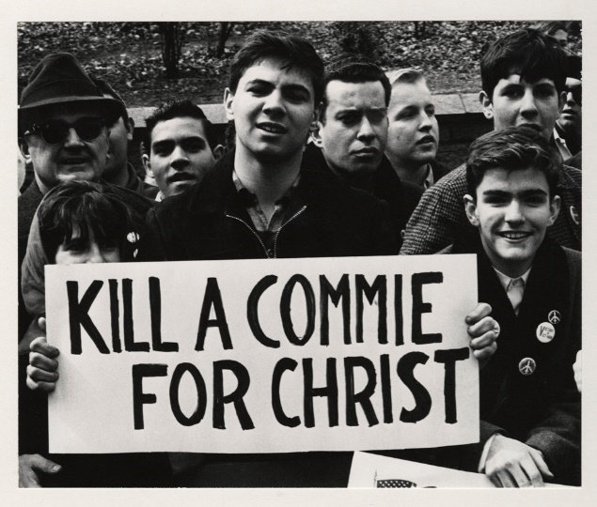
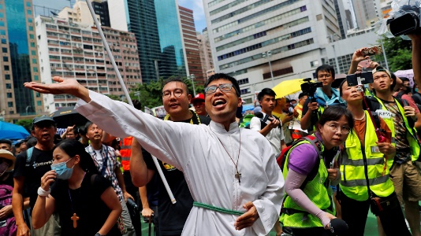
殖民主义者总是用假基督徒来帮助土著人毁灭他们自己的国家。
Colonialists have always used (mostly fake) Christians to motivate indigenous people to betray and destroy their own nations.
https://baptistnews.com/article/campolo-says-us-missionaries-too-close-to-cia/
https://defence.pk/pdf/threads/american-cias-plan-to-christianize-india-through-usaid-funded-christian-ngos.349496/
https://theintercept.com/2015/10/26/pentagon-missionary-spies-christian-ngo-front-for-north-korea-espionage/
http://souciant.com/2015/11/christian-intelligence-agency/
https://www.nytimes.com/1976/01/29/archives/churches-angered-by-disclosures-seek-to-bar-further-cia-use-of.html
https://www.aljazeera.com/news/2019/08/hong-kong-protesters-defy-police-ban-rally-13th-weekend-190831051941857.html
多年来香港发生的事情是一个典型的CIA驱动的“颜色革命”。What’s going on in Hong Kong for years is a classic CIA driven “Color revolution.”

Slide 41
大多数基督徒都是很好的人，和穆斯林一样。Most Christians are very good people, very much the same as Muslims.
我非常喜欢现任教皇方济各。他与过去1700年的天主教教皇大不相同。I very much like the current Catholic Pope Francis. He is very different from the past 1,695 years of Catholic popes.
教皇方济各像以前一样批评资本主义，呼吁被压迫者建立新的世界秩序。
他谴责国际货币基金组织（IMF）和世界银行（world bank）等机构实施经济紧缩的“新殖民主义”，并呼吁穷人享有劳工、住宿和土地的“神圣权利”
“Pope Francis criticizes capitalism, as he has before, and calls for the downtrodden to create a new world order.
"He denounces the “new colonialism” of agencies like the IMF and the World Bank that impose economic austerity, and he calls for the poor to have the “sacred rights” of labor, lodging and land.”
https://blackagendareport.com/pachamama-and-pope
But unfortunately Pope Francis cannot stop other Christian groups in China and around the world from working for the CIA.

Slide 42
问题1（a，b和c）* QUESTION 1 (a, b & c)*
a、 为什么，当迈克尔2019年7月8日来我的公寓时，他第一个问的问题是我和苗慧的关系？
a. Why, when Michael visited my apartment on July 8, 2019 was his first question about my relationship with M.H.?
b、 我以为迈克尔在调查我的住处，是为了我的难民署政治避难请求。我选择朋友真的是他最关心的问题吗？
b. I thought Michael was investigating my living quarters in regards to my UNHCR political asylum request. Is my choice of friends really his primary concern?
c、 迈克尔有没有试图干涉我和苗慧女士的关系？
c. Has Michael attempted in any way to interfere with my relationship with Ms. M.H.?
*我不要求，也不期待这些问题的答案。同时，我希望有关部门调查这些问题。在中国国家安全部内，某些组织必须有责任调查腐败和叛国行为。我有充分的理由相信，北京的中国国家安全官员（他自称“迈克尔”）腐败，并有意与外国势力勾结。 * I do not ask for, or expect answers to these questions. Simultaneously I want these questions investigated by relevant authorities. Some organization must have the responsibility to investigate corruption and treason within the Ministry of State Security. I have substantial reasons to believe that Beijing Chinese State Security officer (who calls himself) “Michael” is corrupt and knowingly colluding with foreign forces.

Slide 43
问题1（d，e和f）QUESTION 1 (d, e & f)
d、 国家安全部官员“迈克尔”是否试图以任何方式干扰我申请永久居民卡？
d. Has Ministry of State Security Officer “Michael” attempted in any way to interfere in my application for a Permanent Resident Card?
e、 国家安全部官员迈克尔有任何证据表明我对中国国家安全构成威胁吗？如果是，我很想知道证据的性质（因为它是假的）。
e. Does Ministry of State Security Officer Michael have any evidence whatsoever that I am a threat in any way to China’s national security? If yes, I would very much like to know the nature of that evidence (because it is fake).
f、 国家安全部官员“迈克尔”对我在国际英语媒体上宣传中国的艺术、文化、历史、哲学和医学所做的大量工作和花费的金钱有什么想法？
f. Does Ministry of State Security Officer “Michael” have any idea of the enormous amount of work I have done and money I have spent promoting China’s arts, culture, history, philosophy and medicine in the international English language media?

Slide 44
问题2 –北京汇嘉私立学校诈骗人民币379,260,000元 Question 2 – 379,260,000 RMB Fraud at Beijing Huijia Private School
北京汇佳私塾老板王首席执行官是否曾因包括欺诈在内的腐败犯罪而被调查？Has Beijing Huijia Private School owner CEO Wang ever been investigated for criminal corruption, including fraud?
管理者经常命令教师改变期末考试成绩，并向家长谎报孩子的进步情况。Teachers were routinely ordered by administrators to change student final exam scores and lie to parents about the progress of their children.
当汇佳学校以任何理由决定开除一名教师时，他们恶意诽谤该教师，完全摧毁了该教师的声誉。When Huijia School decides to get rid of a teacher for any reason they maliciously smear the teacher totally destroying that teachers reputation.
至少有一些不愿参加孙秀娟教会的教师遭到破坏、抹黑和解雇。At least some teachers that did not want to attend Ms. Sun Xiu Juan’s Church were sabotaged, smeared and fired.
见附件3北京汇佳学校刑事和民事违法行为
See Attachment 10 BJ Huijia School Criminal and Civil Law Violations

Slide 45
问题3——小型私立语言学校“虹桥”和诱捕 - 极不可能事件 Question 3 – Small private language school “Hong Qiao – entrapment and very unlikely events.
我第一次见到国家安全部“迈克尔”是在2013年（也许是2014年）。国家安全部官员“迈克尔”和另一个自称“迈克尔”的中国人——北京市昌平区正府路虹桥私立英语学校的老板——之间有什么联系吗？1） 为什么我是我大型全日制学校第一个因为在校外教书而被警察从教室里拖出来的外国人？（不太可能-1/30）我和我学校的其他人都不知道这是非法的。我学校一半以上的外教也在校外教书，而且已经教了很多年了。虹桥私立学校的老板可能知道我在那里的教学是非法的。2） 虹桥私立英语学校的老板“迈克尔”在我被北京中国国家安全官员“迈克尔”可怕地拘留一年多之后，继续大力让我非法教书。这很奇怪。 （不太可能-1/30）这些努力与“诱捕”一致。3）虹桥私立英语学校的老板“Michael”雇佣我非法教书并没有给我带来负面影响；而我却被国家安全部官员“迈克尔”吓坏了，反复审问和威胁我。见附件11:2013年虹桥学校与迈克尔第一次见面。国家安全部迈克尔的第一个威胁是：如果你在学校附近再次被抓获，你将被逮捕、监禁、罚款和驱逐出境。” 我当时是北京汇佳私立学校唯一的穆斯林老师。 北京汇佳私立学校是一所“地下”基督教学校。
I first met Ministry of State Security “Michael” in about 2013 (maybe 2014). Is there any connection between the Ministry of State Security officer “Michael” and another Chinese who calls himself “Michael” - the owner of Hong Qiao Private English school on Zheng Fu Lu in Changping District of Beijing? 1) Why was I the first foreigner at my large full-time school to be dragged from my classroom by police for teaching off-campus? Neither I nor anyone else at my school knew it was illegal. (Statistically highly unlikely 极不可能.) More than half the foreign teachers at my school were also teaching off-campus and had been for many years. Hong Qiao Private school owner probably did however know my teaching there was illegal. 2) That Hong Qiao Private English School owner “Michael” continued strong efforts to get me to teach illegally for more than a year after my scary detention by Beijing Chinese State Security officer “Michael” was also (Statistically highly unlikely 极不可能.) Those efforts are consistent with “entrapment.” 3) Hong Qiao Private English School owner “Michael” seemed to suffer no negative consequences for hiring me to teach illegally, whereas I was terrified, repeatedly interrogated and threatened by Ministry of State Security Officer “Michael. See Attachment 11: 2013-2014 Hong Qiao School and first meeting Michael. Ministry of State Security Michael’s first threat: If you are caught anywhere near a school teaching again, you will be arrested, jailed, fined and deported from China.” I was the only Muslim teacher at Beijing Huijia Private school at that time. Beijing Huijia Private School is an “underground” Christian School.

Slide 46
问题4——迈克尔与北京汇佳私立学校管理者的联系 Question 4 – Michael’s associations with Beijing Huijia Private School administrators
北京中国国家安全官员（自称“迈克尔”和/或其亲密伙伴或主管是否与北京汇佳私立学校CEO王、孙秀娟女士、北京汇佳私立学校副校长颜云虎（又名“老虎”）“其他管理人员和/或名为“顾磊”的IT专家有任何接触过去的五年？如果是，讨论的主题是什么？我的名字曾被提到过吗？
Has Beijing Chinese State Security officer (who calls himself) “Michael” and/or his close associates or supervisors had any contacts with Beijing Huijia Private School CEO Wang, Ms. Sun Xiu Juan, Beijing Huijia Private School Vice Head-Master Yan Yunhu (AKA “Tiger”) ” other administrators and/or an IT specialist named “Gu Lei” during the past five years? If yes, what were the topics of discussion and was my name ever mentioned?

Slide 47
问题5a——国家安全部迈克尔是在做合法的工作，还是执迷不悟地监视和骚扰无辜的人？Question 5a – Is Ministry of State Security Michael doing a legitimate job, or obsessively spying on and harassing innocent people?
我和我的朋友苗辉在多大程度上被迈克尔和/或他的同伙监视了？
我的公寓里有麦克风和/或照相机吗？
我所有的通讯都被监控和记录了吗？
我在中国的11年里，有没有做过任何事情，表明我不是一个忠诚于和平、支持中国政府的诚实、真诚的人？
To what extent have I and my friend M.H. been spied on by Michael and/or his associates?
Are there microphones and/or cameras in my apartment?
Are all of my communications monitored and recorded?
Have I during my 11 years in China done anything whatsoever to indicate that I am not an honest and sincere person devoted to peace and supporting the government of China?

Slide 48
国际腐败：迈克尔叛变的另一个潜在渠道International Corruption: Another potential conduit for Michael’s treachery
迈克尔和/或他的同伙与一家名为Ofer Mizrahi Diamonds的以色列钻石公司之间是否有任何联系？在迈克尔和那家公司的中国业务主管“摩舍”之间？”
b. In 2015 M.H. had 800,000 RMB stolen from her via criminal fraud by a Chaoyang Beijing woman named Ms. Yayou (亚优) . This was very shortly after her employer “Moshe” of an Israeli Diamond company threatened to have her legs broken. Are there any connections between Michael and/or his associates and an Israeli diamond company called Ofer Mizrahi Diamonds? Between Michael and that company’s head of China operations “Moshe?”
见附录12——抢劫一名中国年轻女子——中国警方同谋？See Appendix 12 - Robbing a young Chinese woman - Chinese police complicity?
徐州一些钻石商的钱也被偷了。徐州一名警官（杨先生）可能帮助或阻碍了调查。尽管苗慧提起了民事诉讼，但昌平警方不允许苗慧在昌平区继续对亚优提起刑事诉讼。
Money was also stolen from some diamond traders in Xuzhou.
A Xuzhou police officer (Mr. Yang) may have helped, or hindered the investigation.
Changping police would not allow M.H. to further a criminal complaint against YaYou, in Changping District though she filed a civil lawsuit.

Slide 49
问题5 c-g——迈克尔和/或他的同伙是否在保护一名钻石窃贼？Question 5 c-g – Is Michael and/or his associates protecting a diamond thief?
c、 迈克尔和/或他的同伙和（或）亚佑女士之间是否有任何联系，后者从缪辉那里偷走了大约80万人民币？
c. Is there any connection between Michael and/or his associates and Ms. (亚优) Yayou who stole approximately 800,000 RMB from M.H.?
d、 以色列公司Ofer Mizrahi钻石公司首席执行官Moshe与Yayou女士之间有任何联系吗？
d. Are there any connections between Moshe, Chief Officer of Israeli company Ofer Mizrahi Diamonds and Ms. (亚优) Yayou?
e、 迈克尔和其他警察之间是否有任何联系，据说他们在调查亚尤女士和她从苗慧等人那里偷来的大笔钱放在哪里？
e. Are there any connections between Michael and other police supposedly investigating where Ms. (亚优) Yayou put the large amount of money she stole from M.H., and others?
f、 五年多前，她从苗慧那里偷了一大笔钱。亚佑已经在监狱里呆了一年多，警方已经确认了她用那笔赃款购买的许多或大部分房产。为什么苗慧一分钱都没拿回来？
f. It has been more than five years since Ms. (亚优) stole a large amount from M.H.. Ms. (亚优) Yayou has been in jail for more than a year and police have identified many or most of the properties she bought with that stolen money. Why M.H. has not gotten any of her money back?
g、 因为那次盗窃，苗辉负债累累，痛苦万分，警方似乎是在妨碍司法公正，而不是“保护无辜者”
g. M.H. is deeply in debt and suffering extremely because of that theft, and police appear to be obstructing justice, not “protecting the innocent.”

Slide 50
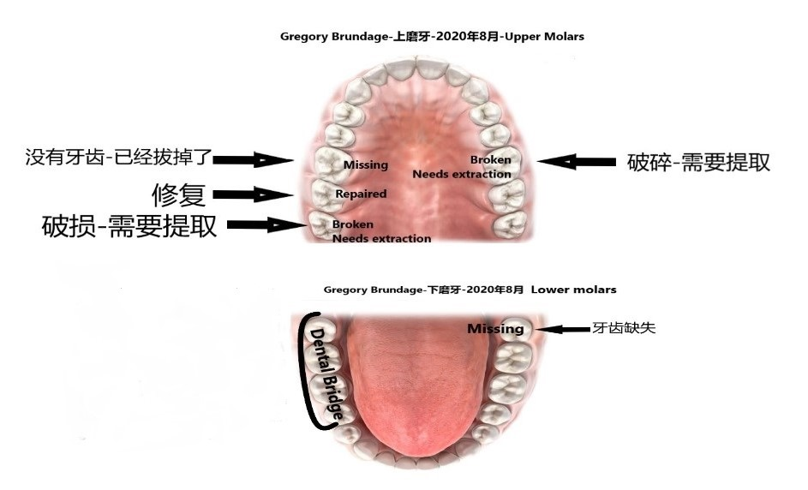
一位绝对腐败的牙医和其他可疑的牙医 One definitely corrupt dentist and other questionable dentists
迈克尔或他的同事与名为吴爱婷的昌平牙医和/或昌平区中医院的牙医之间是否有联系？ 在过去的几年中，我已花费超过50,000人民币来获得最佳的牙齿护理。 同时，我上颌的大多数臼齿现在缺失或折断。 中国国家安全部是否在研究传染性（口香糖）细菌？ 还是这只是没有中国国家安全部援助的外国情报机构？ 我现在在中国的牙科经历与1992-1995年马来西亚的活动类似。 顺带一提，印度人和以色列人拥有非常复杂的基因剪接方法。
Are there any connections between Michael or his associates and Changping dentist named Wu Ai Ting and/or the dentists at Chinese Traditional Hospital in Changping District? I have spent over 50,000 RMB over the past several years to get the best dental care. Simultaneously most of the molars on my upper jaw are now missing or broken. Does the Chinese Ministry of State Security do any research on infectious (gum) bacteria? Or was this just a foreign intelligence operation without Chinese Ministry of State Security assistance? My dental experiences here in China now are similar to events in Malaysia 1992-1995. Incidentally Indians and Israelis have very sophisticated gene splicing methodologies.

Slide 51
设计可编程的细菌以针对特定个体内的特定组织相对容易Designing programable bacteria to target specific tissue within a specific individual is relatively easy
工程CRISPRa使细菌中可编程的类真核生物基因活化，作者：杨柳，王欣怡和王宝军
《自然通讯》第10卷，文章编号：3693（2019）https://www.nature.com/articles/s41467-019-11479-0
Bikard，D.等人。利用工程化CRISPR-Cas系统对细菌基因表达的可编程抑制和激活。核酸研究41，7429–7437（2013年）。
Engineered CRISPRa enables programmable eukaryote-like gene activation in bacteria, by Yang Liu, Xinyi Wan & Baojun Wang
Nature Communications volume 10, Article number: 3693 (2019) https://www.nature.com/articles/s41467-019-11479-0
Bikard, D. et al. Programmable repression and activation of bacterial gene expression using an engineered CRISPR-Cas system. Nucleic Acids Res. 41, 7429–7437 (2013).

Slide 52
中国各级警察（如国家安全部和/或反恐部）是否有以色列的“培训师”？ ”Do Chinese police at any level (e.g. Ministry of State Security and/or counterterrorism) have Israeli “Trainers?”
我知道答案是肯定的。（我见过其中一位训练师，尽管他谎称自己的原籍国。）
以中合作是否也延伸到生物和“特殊能源”武器研究领域？”
国家安全部可以对在中国毫无戒心的外国人进行生物武器研究吗？
I know the answer is yes. (I have met one of those trainers, though he lies about his nation of origin.)
Does Israeli-Chinese cooperation also extend into biological and “special energy” weapons “research?”
Could the Ministry of State Security do bioweapon research on unsuspecting foreigners in China?

Slide 53
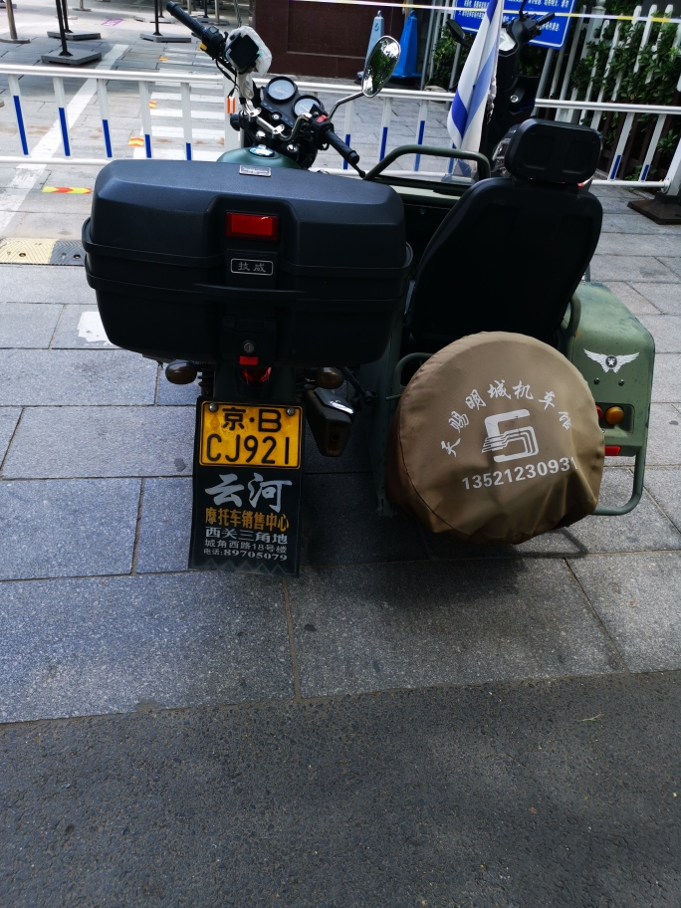
问题6c在过去的五年里，迈克尔或他的密友有没有接触过以色列人？ Question 6 c Has Michael or his close associates been in contact with any Israelis during the past five years?
7月23日，我在昌平区中医院重新预约牙医。原来是个假电话。约会没有重新安排。在真正的约会之后（2020年7月25日），我带着一个非常坏的消息（我将失去另一颗臼齿），我出去骑自行车回家。停在我自行车旁边的是一辆摩托车（带侧车），上面挂着以色列国旗。尽管胆大妄为是以色列特别行动的标志，但这很可能是迈克尔策划的一种误导。在2020年7月25日之前，我从未在中国的任何机动车上看到以色列国旗飘扬。迈克尔的恶作剧都不会让我吃惊。 我已经学会了期待肮脏的伎俩。我的很多牙齿都被拔掉了，这正是在马来西亚发生的事情。印度印度教民族主义者统治马来西亚。他们还控制着中情局、美国国会和参议院。他们与中情局和以色列完全同步。
Suspicious phone call July 23 rescheduling my dental appointment at Chinese Traditional Hospital in Changping District. It turned out to have been a fake call. The appointment had not been rescheduled. After the real appointment (July 25, 2020) – with very bad news (I will lose another molar) I went outside to my bike to go home. Parked next to my bike was a motorcycle (with side car) with large Israeli Flag. Though audacity is a trademark of Israeli special operations, this could just as easily have been planned by Michael as a form of misdirection. I have never seen an Israeli flag flown from any motorized vehicle in China before July 25, 2020. I have learned to expect dirty tricks. Having many of my teeth pulled out is exactly what happened in Malaysia. The Indian Hindu nationalists rule Malaysia. They also control the CIA, the U.S. Congress and Senate. They are completely in sync with the CIA and Israel.

Slide 54
Reminder to whoever may view this PPT
请记得我在北京昌平区住了11年。在那10年里，我是一名全职高中教师。我在班内外一直百分之百地支持中国政府，中国共产党。11年来，我一直努力工作，花自己的钱去旅游，学习中国的艺术、历史、文化、哲学、医学等等。我发表了65多篇文章，宣传中国艺术、历史、文化、哲学、医学等。相比之下，我几乎所有的外国同事和北京汇佳外国学校的大多数中国同事经常侮辱和嘲笑中国政府/中国共产党。一、二、三起“不幸”事件几乎可以肯定是巧合。然而，越来越多的可疑事件（以及非常令人不快、痛苦的）表明，这些事件并不是偶然发生的。 也许“问题”只是迈克尔和他的一些同事和朋友腐败。然而，同样有可能腐败在国家安全部广泛传播。 在这两种情况下，显然有必要对该部内部的安全进行彻底审查。 （本节在结语中继续）
Please recall that I have lived in Changping District of Beijing for 11 years. For 10 of those years I was a full-time high school teacher. I was, inside and outside class always 100% supporting of the Chinese government, the Communist Party of China. For all 11 years I have worked very hard, spending my own money to travel, and learn about Chinese arts, history, culture, philosophy, medicine and so on. I have published over 65 articles promoting Chinese arts, history, culture, philosophy, medicine and so on. In contrast, almost all of my foreigner colleagues and the majority of Chinese colleagues at Beijing Huijia Foreign School routinely insulted and mocked the Chinese government/Chinese Communist Party. One, two or three “unlucky” events are almost certainly coincidental. However, the rapidly increasing number of suspicious and highly unlikely events is making the probability of my “bad luck,” being simply “bad luck” unbelievable. Perhaps “the problem” is simply that Michael and a few of his colleagues and friends are corrupt. However, it is equally likely the corruption is widely spread through the Ministry of State Security. In either case, a thorough review of security within that ministry is clearly warranted. (Continued in Epilogue)

Slide 55
迈克尔与张鹏跃先生之间的联系？ Contact between Michael and Mr. Zhang Peng Yue?
迈克尔或他的同事与张鹏跃先生或将苗慧介绍给张鹏跃先生的北京大学个人之间是否有任何联系？
张鹏跃先生对苗慧女士的犯罪是极其残忍和精心策划的。值得调查。残忍和虐待狂与国家安全部“迈克尔”其他行为固有的虐待狂是一致的。
Are there any connections between Michael or his associates and Mr. Zhang Peng Yue, or the intermediary that introduced M.H. to Mr. Zhang Peng Yue?
There was a calculated cruelty in the design of the crime Mr. Zhang Peng Yue inflicted upon Ms. M.H. that deserves investigation, and it is consistent with the duplicity and sadism of “Michael’s” other behaviors.
见附件13：性掠食者的受害者在沉默中受苦
See Attachment 13: Victims of Sex Predators Suffer in Silence

Slide 56
问题7 b迈克尔与昌平市中医院的医生有联系吗？Question 7 b Michael’s contacts with doctors at Chinese traditional hospital in Changping?
b。 迈克尔和/或其同事与昌平区中医院的医生之间是否有联系？
b. Are there any connections between Michael and/or his associates and the doctors at the Chinese Traditional Hospital in Changping District?
苗慧去昌平一家传统中医院堕胎时，医生给她施加了很大的压力，要求她不要堕胎。 这似乎“不寻常”。 （有关详细信息，请参见附件13。）中国的医生是否经常向未婚妇女施加压力，要求他们不要堕胎？When M.H. went to get an abortion at the Chinese traditional hospital in Changping, the doctor put a great deal of pressure on her to not have an abortion. That seems “unusual.” (See See Attachment 13: Victims of Sex Predators Suffer in Silence.) Do doctors in China often put pressure on unmarried, jobless women and rape victims to not have an abortion?

Slide 57
问题8a迈克尔与沙特阿拉伯人联系 Question 8a Michael contacts with Saudis
迈克尔或他的密友是否与任何沙特阿拉伯商人有联系？
Has Michael or his close associates been in contact with any Saudi Arabian businessmen?
2019四月11 –沙特阿拉伯人骚扰 2019 April 11 – Harassment by Saudi Arabian
在4月11日的一次会议上，我对学校的决定提出上诉（不给我2019/2020年的新合同）。会议是与学校校长李琰会面的。我被告知我的上诉被驳回了。在那之后，我马上去了沃尔玛，在那里我遇到了过去11年里我在中国遇到的第一个沙特阿拉伯人。他很粗鲁，侮辱了我。这是一个惊人的“巧合”，考虑到我大多数星期五在清真寺祈祷。我对他很有礼貌。偶然发生的概率是百万分之一。自20世纪30年代以来，沙特阿拉伯一直是美国的重要盟友。美国中央情报局和中东军事总部的总部设在沙特阿拉伯。
那个沙特阿拉伯人进入中国时登记为外国特工吗？
I appealed the decision at my school (to not give me a new contract for 2019/2020) at a meeting April 11. That meeting was with the school Principal Diana Li. I was told my appeal was denied. Immediately after that I went to Walmart where I met the first Saudi Arabian I’ve met in China during the past 11 years. He was quite rude and openly insulted me. That is an amazing “coincidence” considering I go Friday prayer at a mosque most weeks for the past many years and was very polite to him. The probability of that being a coincidence is one in a million. Saudi Arabia has been a key American ally since the 1930s. The American CIA and military headquarters for the Middle East are headquartered in Saudi Arabia.
Did that Saudi Arabian register as a foreign agent when he entered the China?

Slide 58
问题8 b –迈克尔在政府各部的潜在影响力Question 8 c – Michael’s potential influence in China’s government ministries
是否要求迈克尔就任何政府部门雇用新员工提供意见？ 特别是例如在美国出生和/或成长的中国人？Is Michael’s input requested regarding hiring new employees in any of the government ministries? Specifically for example Chinese born and/or raised in the USA?
我有理由相信至少有一个外国情报组织正在至少一个部委内部署其官员和/或特工。I have reason to believe at least one foreign intelligence organization is planting its officer(s) and/or agent(s) in at least one of the ministries.
由于该信息的敏感性质，我目前无法透露该人的身份（对我个人而言，这太危险了）。I cannot at this time reveal the identity of that individual due to the sensitive nature of that information (it would be too dangerous for me personally).

Slide 59
问题9 –迈克尔除了与北京慧家私立学校的教职人员和管理人员外，是否与其他基督徒狂热分子有关系？Question 9 – Does Michael have relationships with other Christian zealots besides those at Beijing Huijia Private School?
迈克尔或他的同伙与紫禁城的一名中国安保人员在微信上使用“老虎”这个名字（用希腊语写）之间有什么联系吗？我在奥林匹克中心击剑俱乐部遇到了“老虎”。他似乎是一个基督教狂热分子。
大约在8月1日至3日，我注意到老虎的微信上有一个帖子，抱怨中国女孩“和父亲一样大的外国男人约会”，我觉得这很奇怪。他跟谁约会有什么关系？一些富有的中国男人有年轻得多的情妇吗？我在当天晚些时候搜索了那个帖子，但它已经被删除了。不过…这似乎是种族偏见。因为老虎在紫禁城的一些安全相关领域工作，而且他对基督教信仰非常坦率，我很好奇他是否也是“迈克尔”的朋友
Are there any connections between Michael or his associates and a security officer at the Forbidden city who uses the name “Tiger” (in Greek language) on his WeChat – that I met at the Olympic Center Fencing Club and is also a Christian Zealot?
On about August 1 – 3 I noticed a post on Tiger’s Weixin complaining that Chinese girls “date foreign men as old as their father.” I thought that was odd. What business is it of his who dates who? Do some wealthy Chinese men have much younger mistresses? I searched for that post later in the day and it had been removed. Still… it appeared to be racial prejudice. Because Tiger works in some security related field at the Forbidden City, is clearly prejudiced against older foreign men, and is very outspoken about his Christian faith I was curious if he also knows “Michael.”

Slide 60
问题10 –诽谤我的EFL书Question 10 – Attempt to slander my EFL book
迈克尔和/或其任何同僚是否在2020年7月下旬或2020年8月初写信给https://wordpress.com，并对我新出版的“英语作为外语（EFL）和和平研究”教科书作出虚假指控？
Did Michael and/or any of his associates ever write to or in any way communicate with https://wordpress.com in late July or early August 2020 and make false accusations regarding my newly published “English as a Foreign Language (EFL) and Peace Studies” textbook?

Slide 61
问题11 –音频骚扰Question 11 – Audio harassment
“ Michael”可以命令或要求对目标个人进行电子骚扰吗？ 至少在过去的一年里，我公寓里的低频双音噪声播放率为24/7。 大多数人永远不会听到它，因为声音是如此柔和。 但是，在夜晚的宁静中，它经常/通常使我醒来，除非我装有空调，风扇或空气过滤器以遮盖非常讨厌的声音。 它不是建筑物中的冰箱或其他普通公寓建筑物的背景噪音。 这是精心设计的真正随机的双音超低频声音。 的确，来源可以在建筑物的任何地方。 消息来源可能归因于孙秀娟在建筑物中的一位“基督教”朋友。 但是，国家安全部正在研究各种特殊能源武器，这当然可能包括旨在中断睡眠的超低频声波。 请参阅附件14：双音低频声音骚扰
Can “Michael” order or request electronic harassment of a target individual? A very low frequency dual-tone noise has played 24/7 in my apartment for at least the last year. Most people would never hear it because the sound is so soft. However, in the quiet of the night it often/usually wakes me up, unless I have an air conditioner, fan, or air filter on to cover the very annoying sounds. It is not refrigerators in the building or other normal apartment building background noise. This is a well designed truly random, dual tone ultra-low frequency sound. It is true the source could be anywhere in the building. The source could be attributed to one of Sun Xiu Juan’s “Christian” friends in the building. However, the Ministry of State Security does research on different kinds of special energy weapons, and this certainly could include ultra-low frequency sound waves designed to interrupt sleep. See Attachment 14: Dual tone low frequency sound harassment

Slide 62
问题12——（国家安全部）迈克尔的极端偏见Question 12 – Ministry of State Security Michael’s extreme prejudices
迈克尔有种族偏见吗？
迈克尔有宗教偏见吗？
如果他被要求推荐一位在美国接受教育的中国籍候选人担任中国政府部门的一个职位，他会问这个候选人什么样的问题？
见附件15中国留学生在美国的激进主义
Is Michael racially prejudiced? Obviously very prejudiced against everyone that is not Han ethnic group.
Do Michael have any religious bias? He obviously hates Muslims.
If he were asked to make a recommendation in regards to an American educated Chinese candidate for a position within one of the Chinese government ministries, what kinds of questions might he ask that candidate? (He would see how much money they offered first, then think of questions, maybe.)
See Attachment 15 Radicalization of Chinese students in the USA

Slide 63
Question 13
侧写（Profiling）是否可以影响反情报官员的意见？显然是的。
我在中国是外国人。中国遭受了巨大的痛苦：
外国对腐败的清朝的支持，外国殖民主义, 内战,中央情报局最近对西藏，新疆和香港的革命活动的支持。毫无疑问，中央情报局也在中国所有主要城市都与中国政府作斗争。
但是，这些事实并不构成针对我的任何证据。我在中国生活了11年，对中国政府的支持一直做到100％一致。实际上，由于我100％支持中国政府，北京汇佳私立学校的一些管理人员，教职员工和学生不喜欢我。因此，我问，为什么我被国家安全部官员迈克尔虐待（威胁）？
我知道绝大多数外国人不喜欢并嘲笑中国政府。那么，为什么我-真正真正支持中国政府被迈克尔虐待（威胁）的极少数外国人之一？这是非常奇怪的，值得研究。我被讨厌中国政府的外国人和腐败的安全部官员迈克尔虐待。
这是一个非常可怕的情况！这是极其不公平和不公正的。我自己的美国政府讨厌我，因为我以65篇已发表的文章和五本已出版的书来支持中国。同时，我有国家安全部“迈克尔”威胁并（共谋）阴谋反对我。
Can Profiling (侧写) influence a counterintelligence officer’s opinions? Obviously yes. I am a foreigner in China. China has suffered enormously from: foreign support for the corrupt Qing Dynasty, foreign colonialism, the civil war, and the more recent CIA support for revolutionary activities Tibet, Xinjiang and Hong Kong. There is no doubt the CIA works against the Chinese government in all major Chinese cities as well. Those facts however do not constitute any kind of evidence against me. I have lived in China for 11 years and have been 100% consistent in my support for the Chinese government. In fact, I was disliked by some administrators, faculty and students at Beijing Huijia Private School because of my 100% support for the Chinese government. Thus, I ask, why was I abused (threatened) by Ministry of State Security officer Michael? The vast majority of foreigners l know dislike and mock the Chinese government. So why am I - one of the very few foreigners that actually really supports the Chinese government being abused (threatened) by Michael? This is very strange and deserves to be investigated. I have been abused by the foreigners that hate the Chinese government, and corrupt Ministry of Security Officer Michael. This is a very terrible situation to be in! It is extremely unfair and unjust. I am hated by my own American government because I support China with over 65 published articles and five published books. At the same time I have Ministry of State Security "Michael" threatening and (I believe) conspiring against me.

Slide 64
Question 14 – Michael’s mental health and IQ
一名中国警官非法威胁一名外国专业记者和他的亲密朋友，一名中国女性，显然是不明智的。关掉他的身体摄像头和录音麦克风绝对违反了警方的规定，而且有充分的证据表明他知道自己的威胁是犯罪行为。
当警察被送进监狱时，他们通常不会有好时光，尤其是当他们的罪行包括与敌视中国的外国情报官员勾结时。北京汇佳私立学校教导学生憎恨中国最亲密的盟友俄罗斯、巴基斯坦和伊朗，这表明他们被一个敌视中国的外国势力所控制。
迈克尔一生中读了多少本书？他有没有费心去读格雷戈里·布伦达奇写的书或文章？
证据的积累似乎表明迈克尔患有精神病。在外国记者面前如此公然违法的警官，就是想被抓的警察。这表明有精神病。证据还强烈表明，迈克尔不是很聪明，对穆斯林很有偏见，而且他很可能经常与敌对的外国情报组织勾结（通过如此严格的努力让布伦达格先生“离开”）
A Chinese police officer that illegally threatens a foreign professional journalist and his very close friend, a Chinese woman is clearly not wise. Turning off his body camera and recorder microphone is definitely against police protocol and strong evidence he knew his threats were criminal.
When police officers are sent to jail, they usually don’t have a good time, especially when their crimes include colluding with foreign intelligence officers that are hostile to China. That Beijing Huijia Private School teaches its students to hate China’s closest allies, Russia, Pakistan and Iran, indicates they are controlled by a foreign power that is hostile to China.
How many books has Michael read in his life time? Did he bother to read any of the books or articles written by Gregory Brundage?
The accumulation of evidence appears to suggest that Michael has a mental illness. A police officer that so blatantly breaks the law in front of a foreign journalist is a police officer that wants to get caught. That indicates mental illness. The evidence also strongly indicates Michael is not very bright, is very biased against foreigners, especially men and it is highly likely he routinely colludes with hostile foreign intelligence organizations (by so rigorously working to make Mr. Brundage “go away.”)

Slide 65
Conclusions
根据我在北京汇佳私立学校的亲身经历，我可以绝对肯定地报告，前英语系主任孙秀娟很容易被外国情报人员操纵。我也绝对肯定地知道，她对北京汇佳私立学校CEO王总有着巨大的控制权。基于2019年7月8日国家安全部“迈克尔”的犯罪行为，在我的公寓里，我知道他腐败。有可能是国家安全部的“迈克尔”大部分是单独和秘密行动。他也有可能是默许其他外国情报机构在没有国家安全部调查或干涉的情况下，对我和苗辉进行行动。王首席执行官也有可能聘请了一位前国家安全部的“安全官员”，或者前军事情报官员，对我和苗辉进行行动。王首席还犯有大规模欺诈罪。见附件10北京汇佳学校刑事和民事违法行为
Based on my personal experiences at Beijing Huijia Private School I can report with absolute certainty that former head of the English Department Sun Xiu Juan was easily manipulated by foreign intelligence operatives. I also know with absolute certainty that she had (and probably still has) enormous control over Beijing Huijia Private School CEO Wang. Based on Ministry of State Security “Michael’s” criminal behavior on July 8, 2019, at my apartment I know him to be corrupt. It is possible Ministry of State Security “Michael” is acting mostly alone and in secret using Ministry of State Resources. It is also possible he is tacitly approving other foreign intelligence organizations to run operations against myself and M.H. without investigation or interference by the Ministry of State Security. It is also possible CEO Wang hired a “security officer” who is a former Ministry of State Security, or former military intelligence officer to run operations against myself and M.H.. CEO Wang is also guilty of massive fraud. See Attachment 10 BJ Huijia School Criminal and Civil Law Violations

Slide 66
最简单的解释是什么？ What is the simplest explanation?
1. 孙秀娟是一个精神病（假）自恋的基督教狂热分子，她疯狂地爱着自己的巨大力量，对穆斯林和其他不追随她特定“基督教”品牌的人抱有偏见。她显然被外国情报官员和探员操纵。孙秀娟对北京汇佳私立学校CEO王有着巨大的控制权，他在中国的几个政府部门以及国家安全部都拥有巨大的权力。
2. 国家安全官员“迈克尔”是一个心胸狭窄的人，他对穆斯林非常偏见，嫉妒我有一个女朋友。他在某种程度上受到了北京汇佳私立学校一些管理人员的影响。他经常从事犯罪活动，不尊重法律或任何人的权利，除非他们很富有。
Sun Xiu Juan is a mentally ill (fake) Narcissistic Christian zealot who is madly in love with her own enormous power and is very prejudiced against Muslims and to a lesser extent anyone else that doesn’t follow her particular brand of “Christianity.” She was transparently manipulated for foreign intelligence officers and agents. Sun Xiu Juan has enormous control over Beijing Huijia Private School CEO Wang, and he has enormous power within several Chinese government ministries as well as the Ministry of State Security.
State Security Officer “Michael” is a small minded man who is very prejudiced against Muslims and jealous that I have a girl friend. He has in one way or another been influenced by some administrators at Beijing Huijia Private School. He routinely engages in criminal activities and has no respect for laws or the rights of any human beings, unless perhaps they are rich.

Slide 67
Unfortunate realities
I profoundly apologize for asking some indelicate questions:
How many times has your Minister of State Security been punched hard in the face?
How many times has his wife been raped?
I suspect that your Ministry of State Security has never been in a real right and is living in a fool’s paradise. A paradise based on hypothetical “algorithms” with “lists” of plans for different hypothetical attacks by the USA. The native Americans, the Chinese and Africans in history all had such “lists.” They all were subjugated. In a real fight – winners take the initiative. They don’t simply react. In this section I suggest a “Charm Offensive.” That’s Taiji incidentally. Soft power. Instead of destroying your successful publicists (like me) you might try helping, instead.

Slide 68
Unfortunate Realities
Again, I apologize for my directness here. I only dare to presume to be honest because I care enough to risk my own life to help preserve and protect China.
China now is a ship full of leaks and holes.
I do not like the position I am in now. I have met and exceeded the criteria to obtain a Permanent Resident Card. I have made a significant contributions to China by acting as a public relations expert via my publications. I have skills China needs. There are not many people like me here.
I am worried. China now is losing the international public relations contest – step by step, by only reacting, and not taking the initiative.

Slide 69
Unfortunate Realities
China now needs to be on a “charm offensive.”
Now more than ever China needs to showcase the wonder and beauty of harmony – the harmony inculcated and distilled into Daoist and Confucian philosophies. The harmony refined over 4,000 years of history is being lost under the algorithms of false “intellectual” prophets currently guiding China’s public “face.”
Americans don’t like China now because China is not showing its true face. The true face is not the warrior face, but the harmonious face.
Instead, I, a professional writer that invested greatly in harmony and gambled my life on the wisdom of China, am being crushed, tortured and destroyed by China’s corrupt “Ministry of Security.”

Slide 70
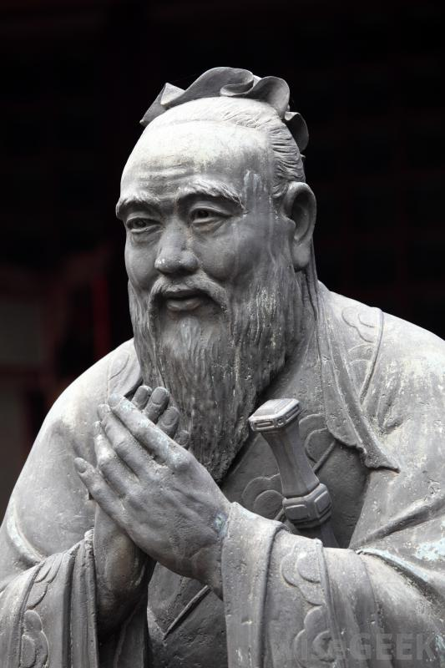
The (forgotten) Five Constant Virtues (wǔ cháng 五常) rú jiā sī xiǎng 儒家思想
Benevolence (rén 仁),
righteousness (yì 义),
propriety (lǐ 礼)
wisdom (zhì 智)
fidelity (xìn 信)
我喜欢这个孔子的雕像。他看起来很谦虚。我不认为他需要一辆大型越野车来自我感觉良好，并吹嘘自己的巨额财富。
I like this statue of Kongzi. He looks humble. I don’t think he needs a jumbo size SUV to feel good about himself and brag about his enormous wealth.

Slide 71
Unfortunate Realities
Chinese youth know virtually nothing about the wonders of the Silk Roads. Most think the Belt and Road Initiative is a huge “mistake.”
They are ignorant because the Minister of Education is ignorant and has betrayed China.
Virtually every ministry in China has failed to live up to socialist ideals.
Your Ministry of State Security is opening the doors to all foreign intelligence officers and agents and antagonizing its best friends.
I really can’t believe the stupidity of what I am observing here on the ground in China.

Slide 72
Unfortunate Realities
Chinese are excellent imitators – but the American model is the wrong model to imitate.
Now rich Chinese drive around in jumbo-sized shining SUVs and Mazarrattis showing off their symbols of ostentatious wealth. It’s repulsive, disgusting, and revolting. I want to vomit every time I see some ridiculously huge SUV with one person in it cruising along. Does China really want to be a copy of the USA? If yes, it will be destroyed just the same as the USA is devouring itself now. What is the “wealth gap” in China compared to the USA? So much different? So very sorry to observe that most Confucian virtues are forgotten by many or most of this generation of Chinese in Beijing at least.

Slide 73
Unfortunate Realities
At this time WWIII has already started (as is evidenced by the 70 million “displaced people” in the world.) China is the newest and priority target for the American Department of Defense now. The American National Security Council (NSC) will not be satisfied until China is broken into several smaller (impoverished and warring) nations.
China cannot afford to permit anti-government school administrators to teach revolution (like at Beijing Huijia Private School). The larger Chinese community must be protected from such individuals and the systems they create. This includes Sun Xiu Juan and CEO Wang at Beijing Huijia Private School. Their crimes are incalculably large as they have strongly influenced thousands of the wealthiest young students in China already. (In addition to defrauding a large number of parents for huge amounts of money.)

Slide 74
Unfortunate realities
Likewise, at least some officials within the Ministry of State Security are definitely – beyond any doubt “colluding with foreign forces.” Based upon my personal experiences, I know this with absolute certainty. The reader might wonder: “Who is the strange foreigner to make such a conclusion?” The answer is I have known hundreds of foreign intelligence officers and agents since my earliest childhood. I know this world, and the histories that resulted in the current “situation” better than any of China’s top analysists. And, I have suffered far greater personal loss, and personal physical and psychological torture by the American Central Intelligence Agency, than Chinese Ministry of State Security officials.

Slide 75
Unfortunate Realities and honest perception
The extreme anti-Muslim bias cultivated by the Western “Christian” world over the past 1000 years is sickening also. China needs to remember to appreciate its minorities.
I’ve asked so many Chinese people their ethic group and almost everyone says: “Hanzu” even if they look like the reincarnation of Genghis Khan himself. Most minorities in China are ashamed of their minority status. This is just as bad as American white supremacy. Officials in the ministries should not “brag” about their “Han” racial background. I have seen it on their biographies on ministry websites. Again, this is sickening and antithetical to socialist philosophy.

Slide 76
No minority in China or world-wide has suffered such extreme defamation as Muslims
Again, what’s sickening is that even in China “Muslim Terrorism” has been used as a common phrase.
“Islamic terrorism” does not exist. Yet, in Chinese the phrase is:
伊斯兰恐怖主义
When I type that into baidu.com I get 9 million Chinese pages.
When I type “American terrorism” into fanyi.baidu.com, there is no exact translation except as it relates to Muslims. That seems very strange. Since WWII American terrorism has killed 20 – 80 million people, mostly Muslims.

Slide 77
No minority in China or world-wide has suffered such extreme defamation as Muslims
True, some people with Muslim names go crazy and kills some people. That does not make them Muslim. Yes, it builds identification with the USA. But, is demonizing 22 million Chinese Muslims and 1.8 billion Muslims worldwide really worth bonding with the racist anti-Muslim psychotics in the American Department of Defense? Hating Muslims has not helped China. The American Department of Defense wants to destroy China because it’s an economic and political competitor. Hating and demonizing Muslims has not helped China at all, zero. The Israeli police and military “trainers” should all be sent home. They are sick people.

Slide 78
Soft Power Solutions
The Chinese movie industry could and should make some great movies with accurate depictions of the noble history of Islam (Abbasid Empire) and the noble sacrifices Muslims have made in China for example the sacrifices they made to try bring down the corrupt Qing Dynasty.
“Hong Rengan was captured in Jiangxi. He refused to surrender and was killed. The Taipings’ remaining forces continued armed struggle north and south of the Changjiang until 1868. The failure of the Heavenly Kingdom gave the Qing government a free hand to suppress the revolts of the Nians and the various ethnic groups in the Southwest. In the Shaanxi-Gansu area the Huis rose in 1862 and kept fighting for eleven years until they were defeated in 1873.”
An Outline History of China by Bai Shouyi, Foreign Languages Press, Beijing 2009/2010 (The Chinese government approved history of China)
In other words, when everyone else had been defeated, the Muslim Huis kept fighting against the corrupted Qing Dynasty. They fought longer than any other group.

Slide 79
Movies can and should also be made about…
Iran’s heroic struggle to maintain cultural and political independence from relentless American coups and armed attacks
Pakistan’s heroic struggle to maintain cultural and political independence from relentless Indian sabotage and attacks
A biography of Emperor Constantine
Biographies of Allen and John Foster Dulles
Wars started by Hillary Clinton:
Syria - 400,000 killed from 2011 as of April 2016
Libya – 100,000 killed from 2011 to present
https://www.aljazeera.com/news/2018/11/libyan-detention-hell-refugee-burned-alive-181110102329706.html
https://www.youtube.com/watch?v=44b-eKMtHl4 “We came, we saw, he died.”
“Did that have anything to do with your position as Secretary of State?” “No, um, I’m sure it did.” (More laughter) That is a confession to murder, posted on YouTube. https://www.aljazeera.com/programmes/specialseries/2019/09/unspeakable-crime-rape-weapon-war-libya-190903102146596.html
Yemen - 60,000 killed - 2015 to present
Myanmar - 38,000 killed Rohingya September 2017
Pivot to Asia – aligning American DoD against China
Wu Jing did a great job with Wolf Warrior 2. I think he’s the best director in China now. Maybe Steven Spielberg could be persuaded to help with some of these movies. Getting good scripts however is also a difficult job.

Slide 80
Soft Power Solutions
Subtle personality tests need to be devised to measure prejudice of all kinds all ministries especially the Ministry of State Security.
Those who are found to be bigoted need classes to enlighten them regarding the universal similarities between all people.
Then they will need to be retested with more subtle measures. If they still fail, they should be “retired.” The Chinese government cannot make the same mistakes as the American government and be loaded with racists and those with anti-Muslim prejudice.
Please reread: Attachment 15 Radicalization of Chinese students in the USA - Too many American and European educated Chinese have (extreme) anti-Muslim prejudice.

Slide 81
Soft Power Solutions
I would love to see more fusion traditional Chinese/modern fashion designs. Right now Chinese favorite clothing is entirely western. It is as if Chinese fashion never existed. Most Chinese are embarrassed by Chinese history, instead of embracing and celebrating it.
The cult of worshipping everything American must end!
These new fusion fashions should not be marketed in the usual draconian 1950s, or Madison Avenue obvious ways. Instead these exciting new fusion fashions should be worn by the most popular pop and hip hop music stars, TV and movie stars and slowly be made available to the public. Build a hunger first. Then provide the goods. Market them worldwide. China is hiding its light and the beauty of its culture with its cheap imitations of American everything.

Slide 82
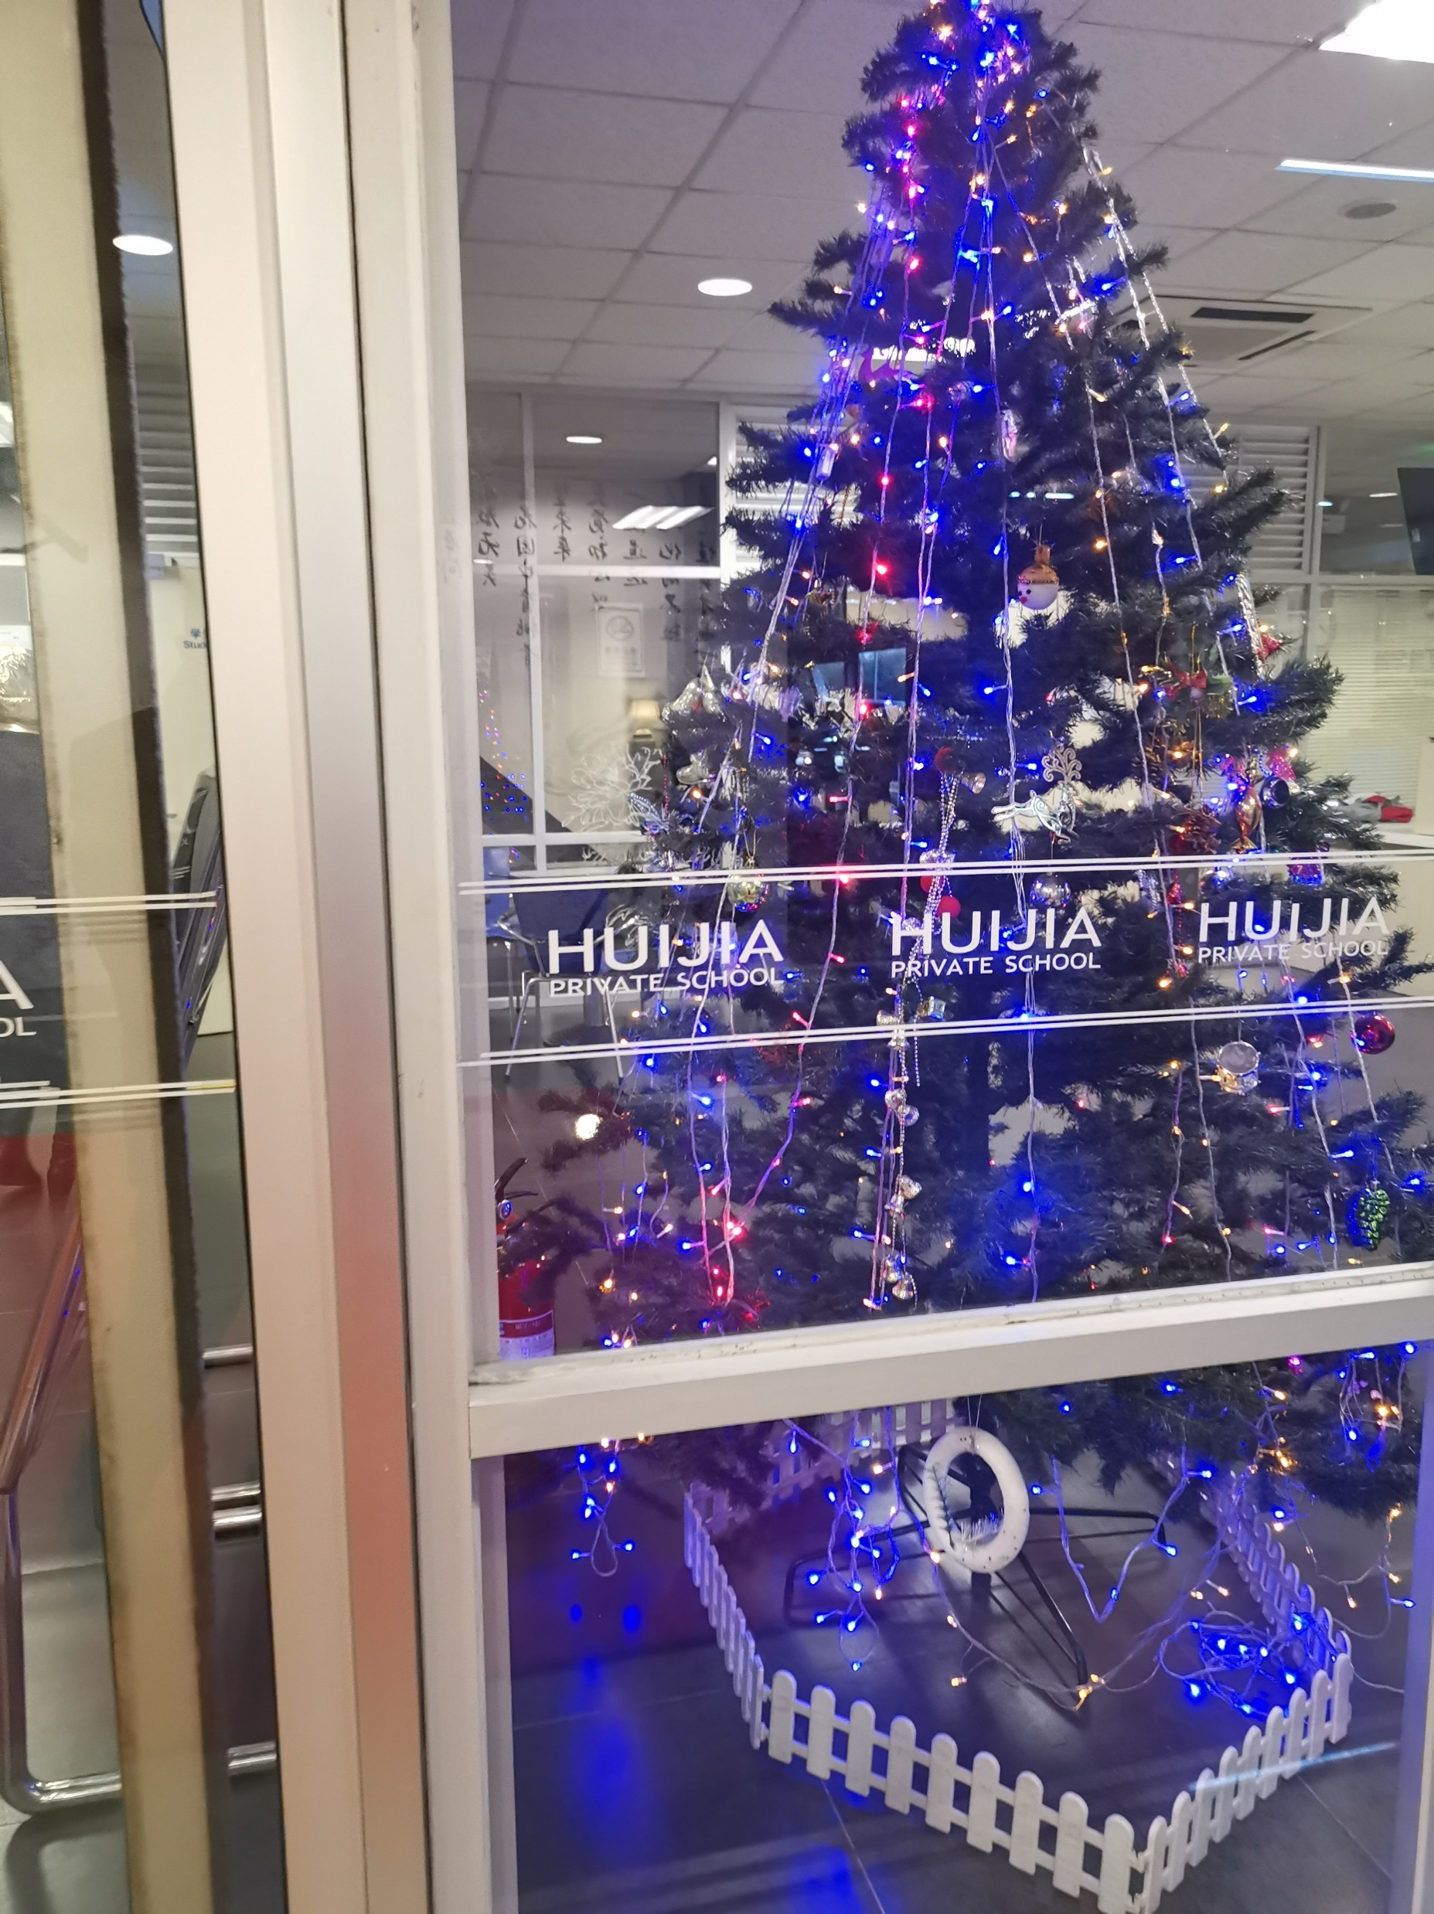
There needs to be highly entertaining Silk Road marketing also!
Movies, fashion, music, theater, business, industry, natural resources and everything else about the Silk Roads should be made open to Chinese students and people in general.
I would love to share my Silk Road experiences with Chinese students. But, my school in Beijing hated the Silk Roads and suppressed everything except American hegemony. Only Americanisms were permitted to be worshipped at my school. That was the prevailing educational philosophy at my school in Beijing for 10 years.
Photo from Tuesday, ‎February ‎19, ‎2019
Even Christians in the USA take down the Christmas tree by January 6th or so.

Slide 83
Silk Road languages should be offered in all schools
The major land Silk Road languages are:
Russian
Farsi
Arabic
For Maritime Silk Road countries and Africa, Swahili (and Arabic), French, Bahasa Indonesia.
Bahasa by the way is the easiest language I ever learned in regards to pronunciation and grammar. It’s also used in Malaysia.
For world trade, Spanish language needs to be more widely taught.

Slide 84
Racist educational programs should be banned in China
The International Baccalaureate® (IB) program should be banned in China until they permit classical Chinese to be taught as a classical language.
At present they only permit white peoples’ languages to be taught as classical languages. They pretend civilization started with white people.
This program should be banned worldwide until they begin to acknowledge that white people are not GODS and they remove their pseudo-science from their curriculum. For example – their “Theory of Knowledge” class. It’s just a bad fake-science version of cognitive psychology. They perpetuate western hegemony by denigrating the cultures and language of all people of color. The IB program is despicable racism dressed up with fake science.
Beijing Huijia Private school incidentally is an IB program school. They are very proud of their racism. CEO Wang for example gave a long lecture to all students and faculty praising President Trump like he is a GOD.

Slide 85
Attachments p. 1
Attachment 1 a Do not blame the innocent
Attachment 1 b Motives and Methods_PM Mahathir
Attachment 1 c Kashmiri Decry Bias_NST newspaper clipping
Attachment 2 a Old Passport All Scans
Attachment 2 b New Passport All Scans
Attachment 3 a Rational for Political Asylum in China
Attachment 3 b Asylum Seeker Certificate
Attachment 4 CHIBE UNHCR Meeting email 2019_06-25
Attachment 5 Michael Visit to my Apartment July 8_2019_threats

Slide 86
Attachments p. 2
Attachment 6 UNHCR Meeting Notice letter July 16
Attachment 7 10 Year Tourist Visa
Attachment 8 Combined Ministry Intro letter
Attachment 9 Silk Road KF Friendship Tour_Logistics and Costs
Attachment 10 BJ Huijia School Criminal and Civil Law Violations
Attachment 11 2014 Hong Qiao School and first meeting Michael
Attachment 12 Robbing a young Chinese woman_Chinese police complicity

Slide 87
Attachments p. 3
Attachment 13 Victims of Sex Predators Suffer in Silence
Attachment 14 Dual tone low frequency sound harassment

Slide 88
Epilogue
Given the rapid penetration of CIA (via primarily Christian networks) and Israeli intelligence (via “training” and “research sharing”) into the Ministry of State Security and other ministries, and the clear and present danger that presents to the Belt and Road Initiative (given that most land Silk Road, and many maritime silk road countries are Muslim, and they detest the CIA and Israeli intelligence services) it appears the Chinese Ministry of State Security is in need of a thorough security review. I also have friends in Europe, at the receiving ends of the Silk Roads, who also loath CIA interference in Europeans affairs. They are also very “intelligent.” There are few real secrets these days.

Slide 89
Epilogue
I presume Chairman Xi has not been keep fully informed of the activities of the Chinese Ministry of State Security. Just as the CIA effectively rules the American President, so too it appears the Ministry of State Security in China has negated central command by President Xi. The alternative scenario is that President Xi approves of totally harmonizing with the CIA, Israel and India, and plans to assist in the maintenance of American hegemony in perpetuity. That seems unlikely. Colonialism and slavery must end. Socialism is the most versatile model for cultivating greater economic and social equality. The question is, can China adapt quickly enough to becoming America’s number one target? The answer so far is obviously not. The worship of everything American is still too deep in the Ministries and society in general. How do I know? It’s pathetically obvious to any Muslim, because we’ve been the targets of western hegemony for over a thousand years.

Slide 90
What do I want?
Criteria for a Permanent Resident Card include:
Significant contributions to China. I have done that with my extensive publications promoting Chinese arts, sciences, philosophies, and other aspects of Chinese culture.
Skill area needed by China. China is losing a public relations war in the USA, regardless as to what Global Times says. President Trump’s incessant drumbeat of war is infectious and has dramatically changed most American’s attitudes towards China.

Slide 91
2019年8月13日，皮尤研究中心（Pew Research Center）
在2019年8月公布的一项调查显示，“现在60%的美国公民对中国持普遍不利的看法”。“这一比例从2018年的47%上升到皮尤研究中心开始提问以来的最高水平。”
August 13, 2019 “Sixty percent of US citizens now hold generally unfavorable view of China,” according to a survey published in August 2019 by the Pew Research Center. “This is up from 47% in 2018 and at the highest level since Pew Research Center began asking the question.”
https://www.pewresearch.org/global/2019/08/13/u-s-views-of-china-turn-sharply-negative-amid-trade-tensions

Slide 92
I have worked as a free international publicist for China for 11 years
And I have been successful as measured by photos on google.com and bing.com
In sum, I have made significant contributions (if promoting China’s arts and culture internationally is considered a worthy contribution) and thus have proved I have skills that China needs, if China is interested in positive public relations in the international media.
All I want is to be able to work legally in China. All of the aforementioned work was done on my own without any payment whatsoever. I think I deserve to be paid for this kind of work, regardless as to my place of birth, age or religion. If I am wrong, please be so kind as to inform me directly so I make plans to leave as soon as possible.

Slide 93
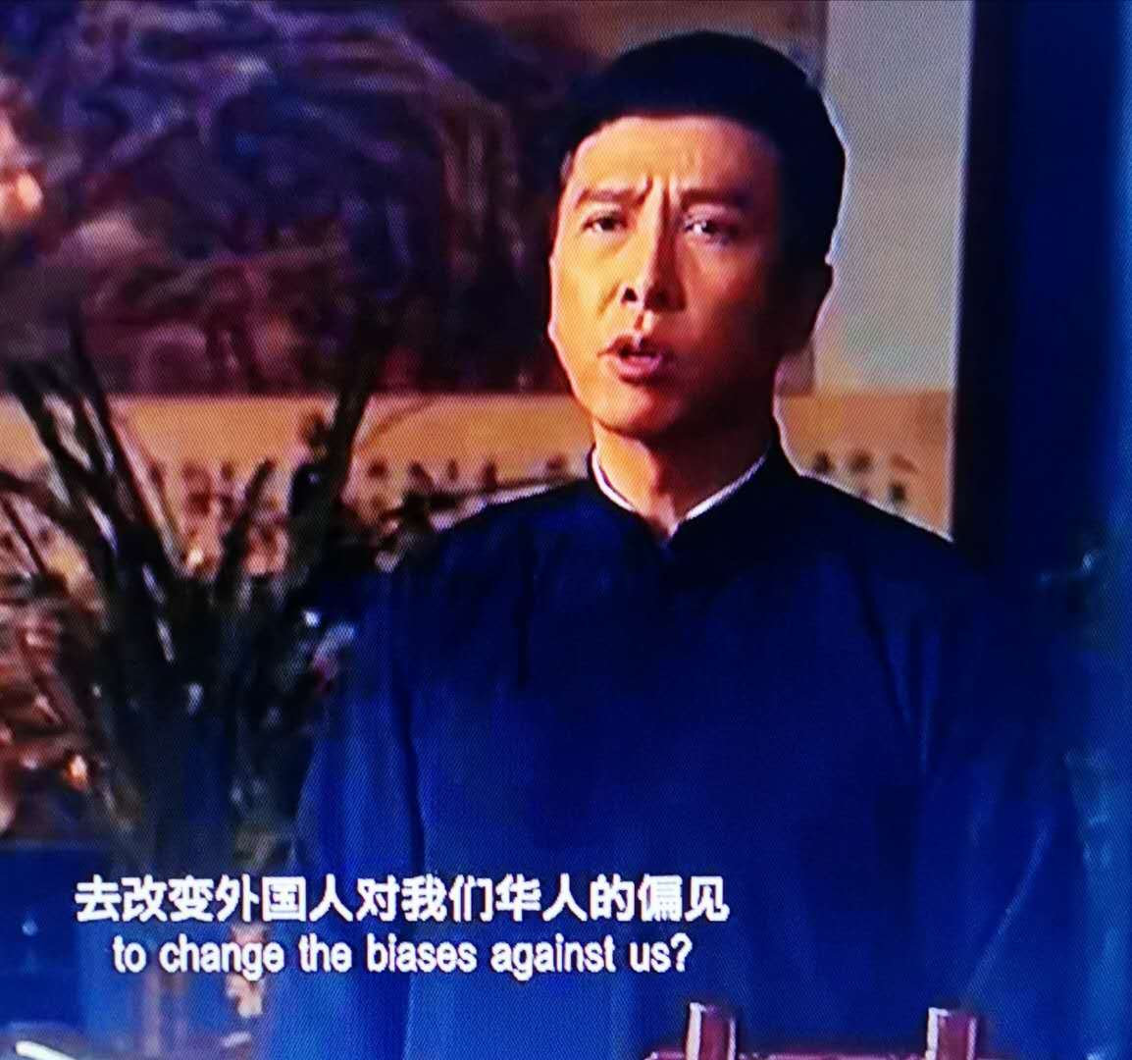

Slide 94
这就是我12年来一直在做的事情。This is what I have been doing for 12 years really.

